Slide 1



Capturing land policy effects with spatial analysis
a Comparison of densification patterns in Utrecht and Bern
Doctoral defense of Vera Götze Geographical Institute, University of Bern, 30 August 2024

Slide 2
Provide evidence, test and build hypotheses
“How much green space is lost?”
“By how much did the city grow?”
“How dense is this neighborhood?”
QUALITATIVE, CASE-BASED INSTITUTIONAL RESEARCH
Mechanisms, process tracing, theories, high level of detail, depth
a
Small-scale, not always representative
SPATIAL ANALYSIS
Large-scale comparison of phenomena across regions, width
a
+
+
–
–
High level of abstraction, lack of detail and data, how to isolate the effect of planning?
“Who are the landowners?”
“Who has access to green spaces?”
“Where does replacement construction happen?”
“Who gets evicted, who moves in?”
Provide theory and mechanisms to explain observations
Introduction

Slide 3
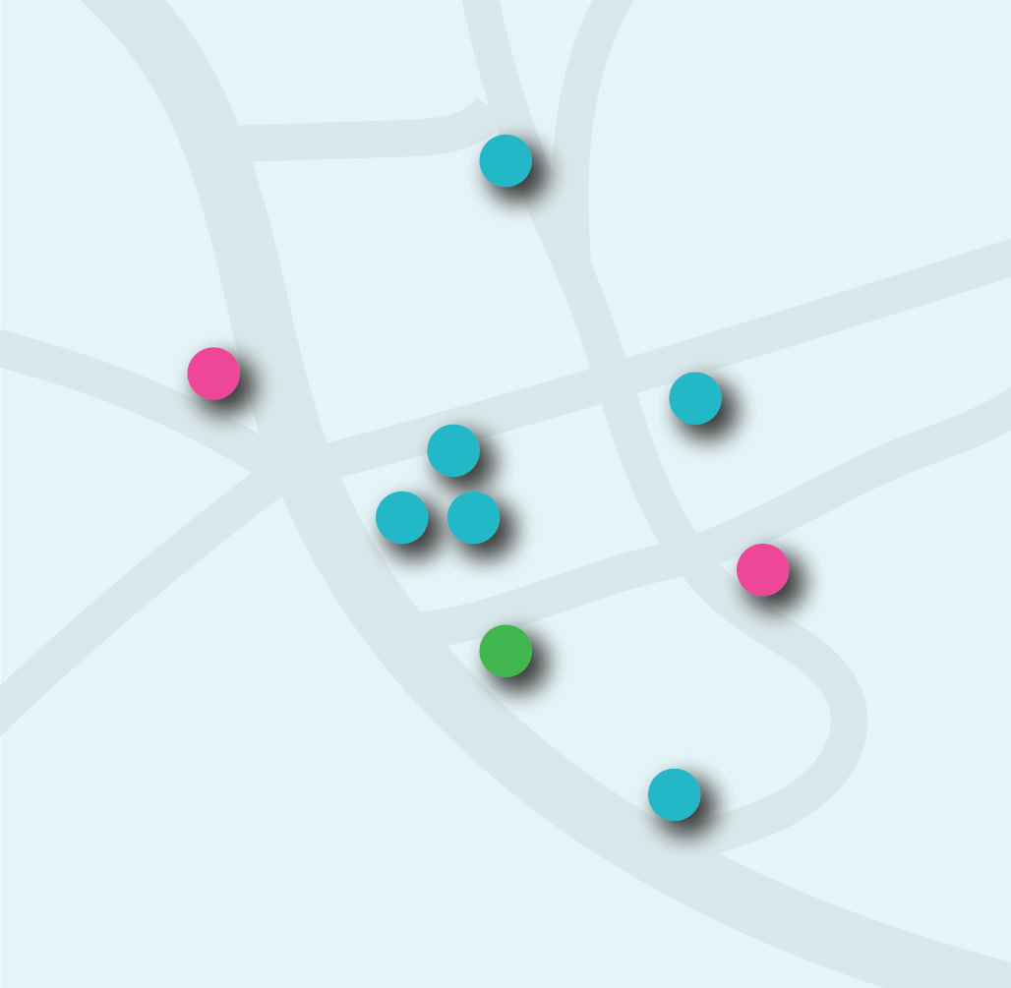
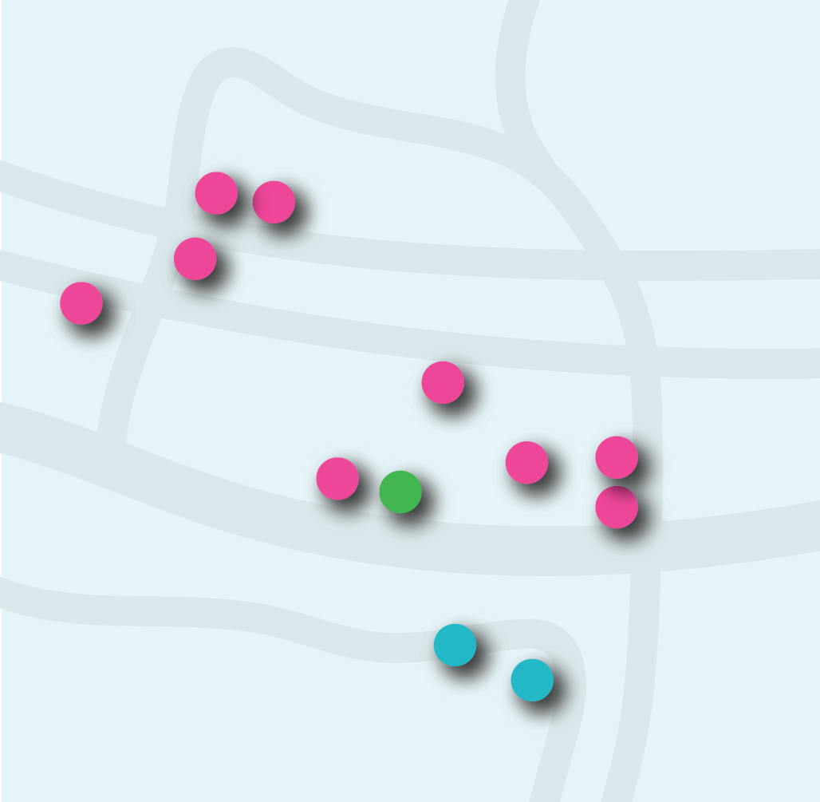
COMPARING DENSIFICATION PATTERNS
How does the comparison of densification patterns contribute to tracing land policy effects?
What densification patterns emerge across countries and municipalities?
How does land policy possibly explain the observed differences?
Introduction
Introduction

Slide 4
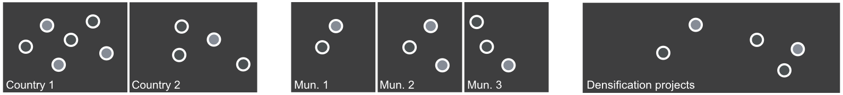
1
2
3
Effect of institutional framework on densification patterns across countries
Effect of policy instrument application on project outcome
Effect of municipal strategy on densification patterns across municipalities
Comparison between model and reality; multi-method approach
Comparison across space; typology of densification
Comparison across space; indicators of planning process
Findings

Slide 5
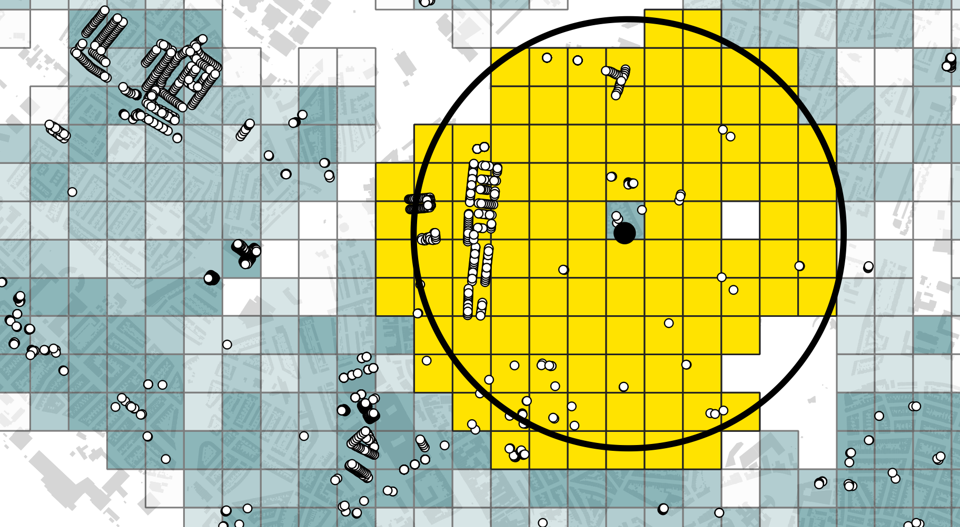

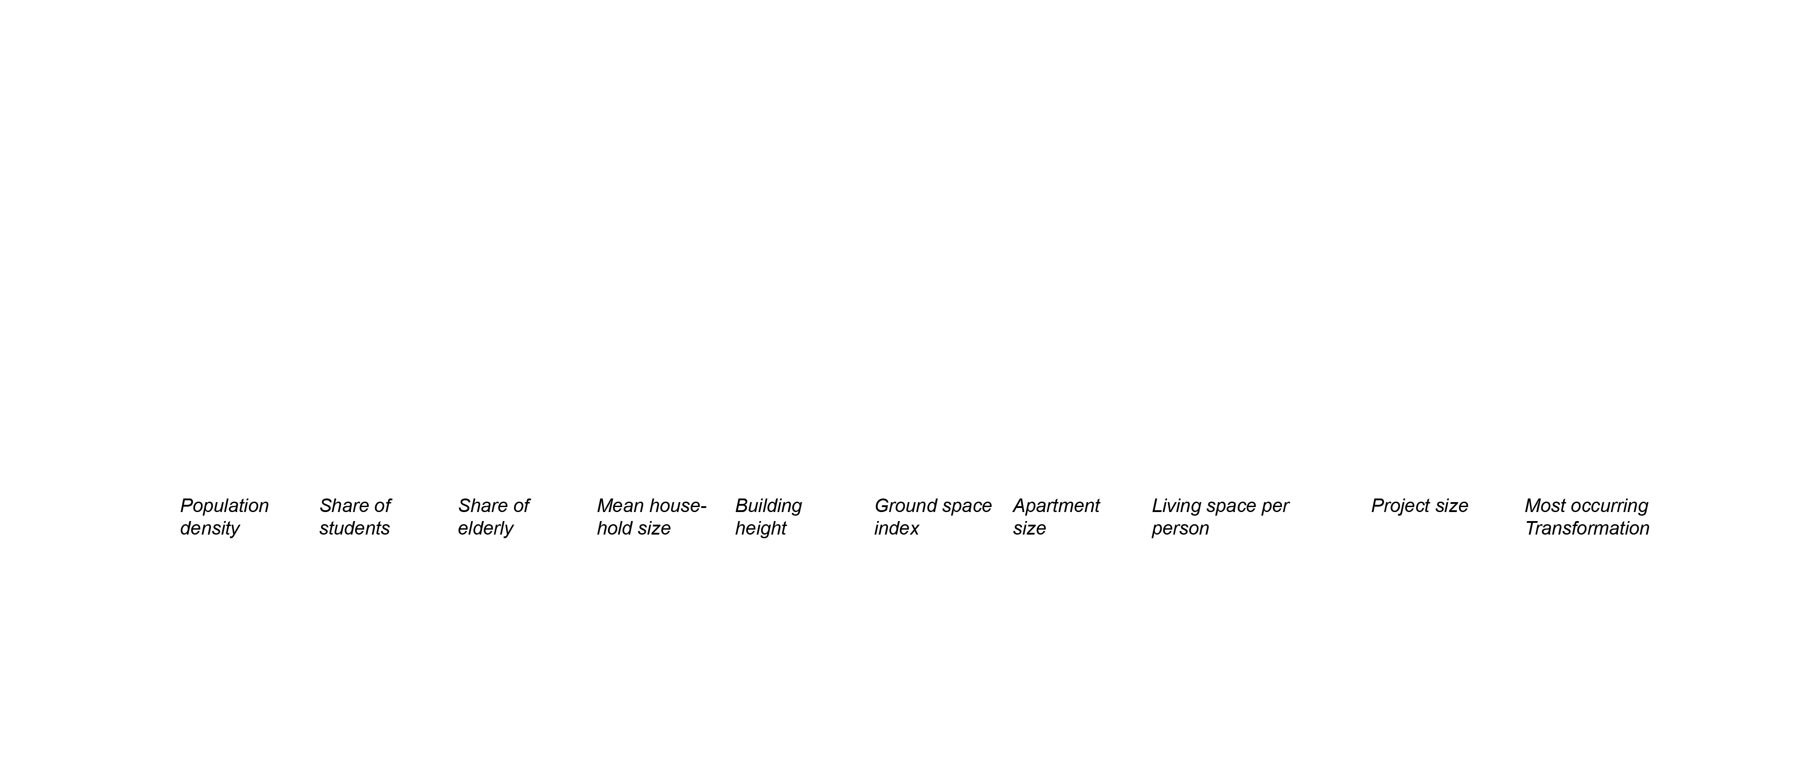
1
2
3
Effect of institutional framework on densification patterns across countries
Effect of policy instrument application on project outcome
Effect of municipal strategy on densification patterns across municipalities
Comparison between model and reality; multi-method approach
Comparison across space; typology of densification
Comparison across space; indicators of planning process
1 km² surroundings
Findings

Slide 6
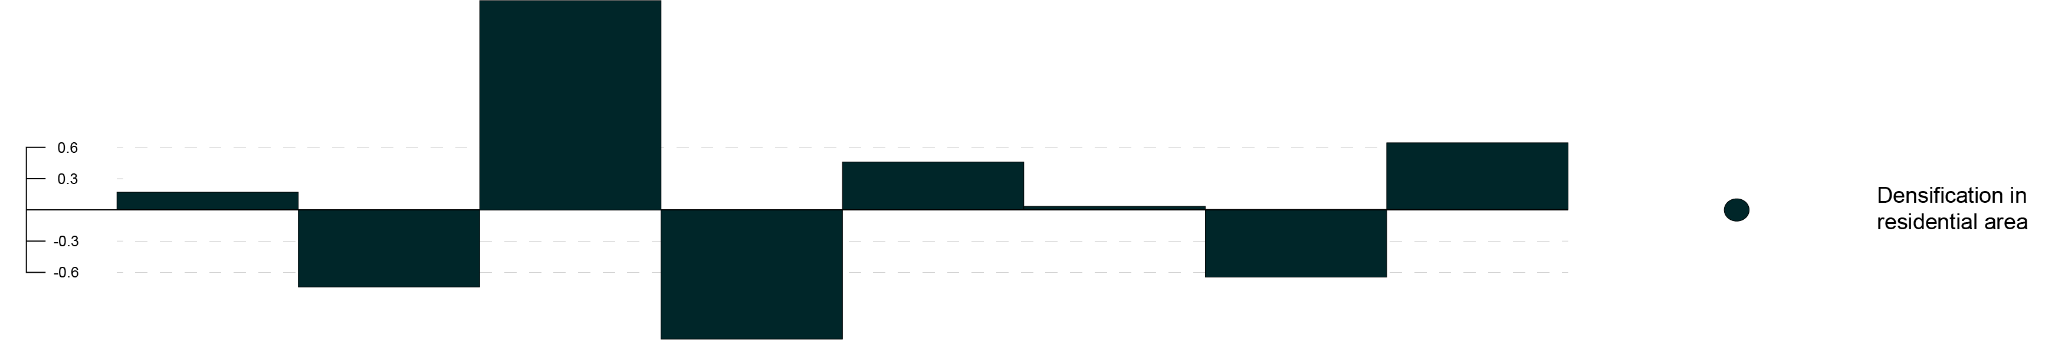
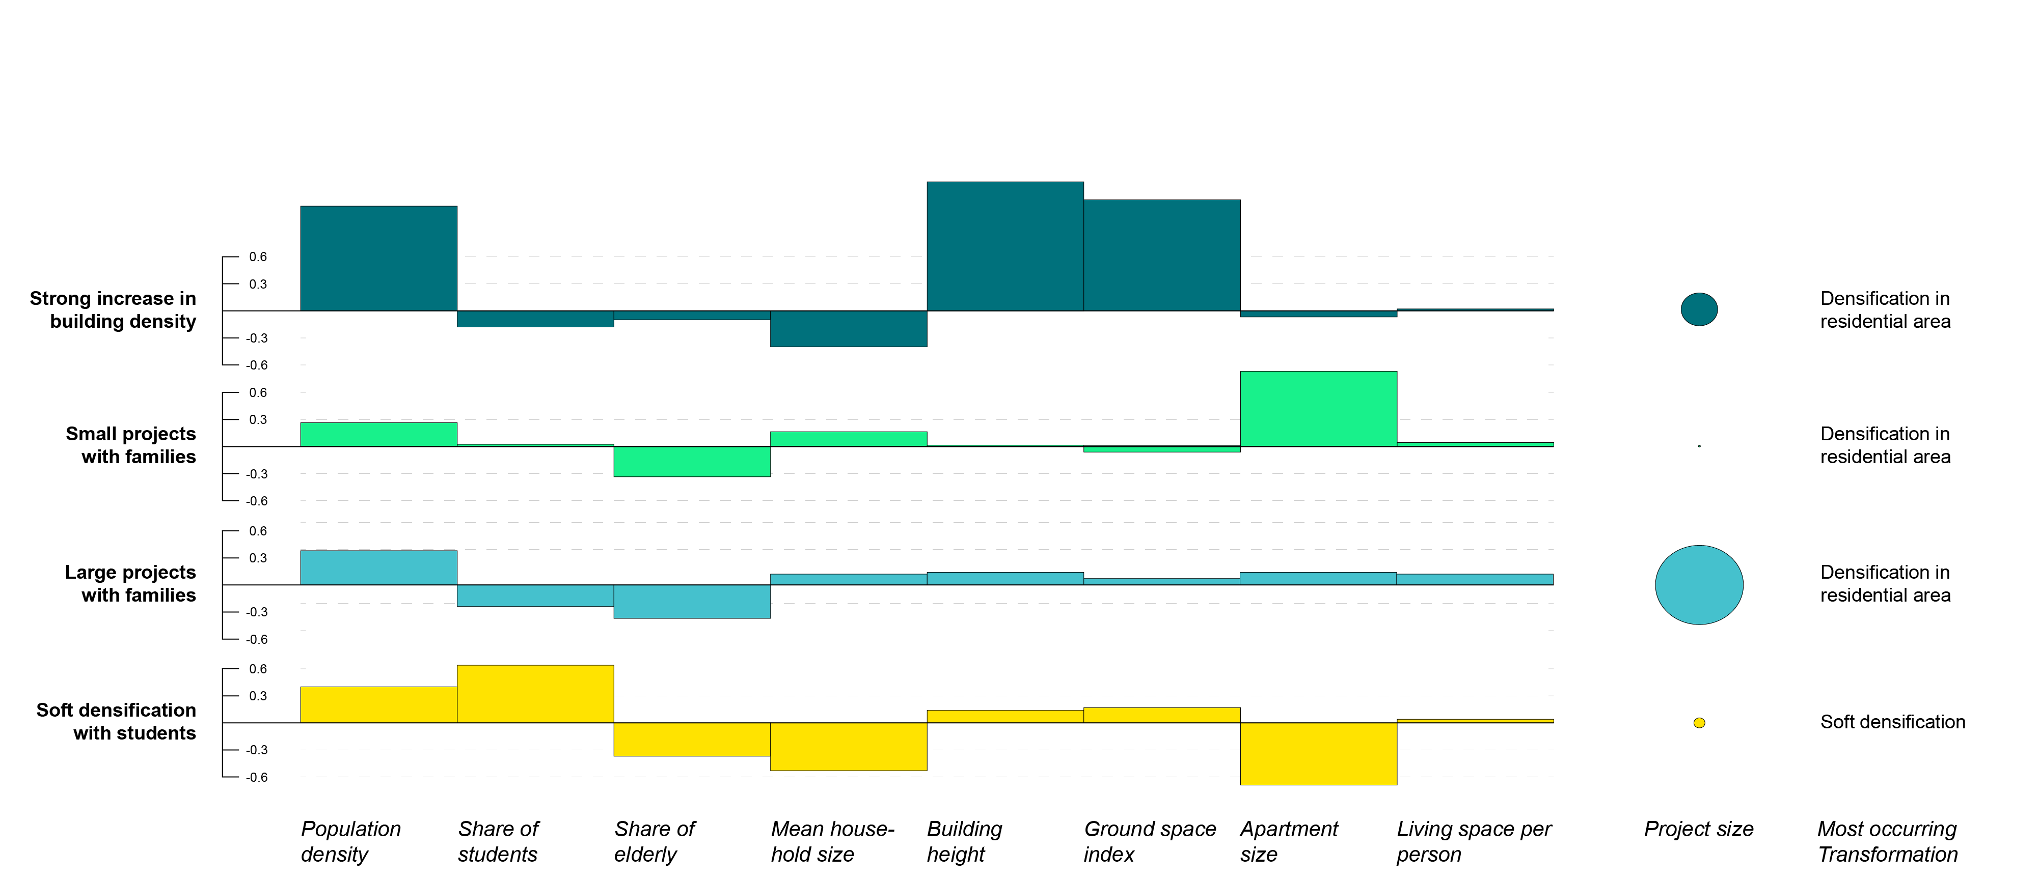
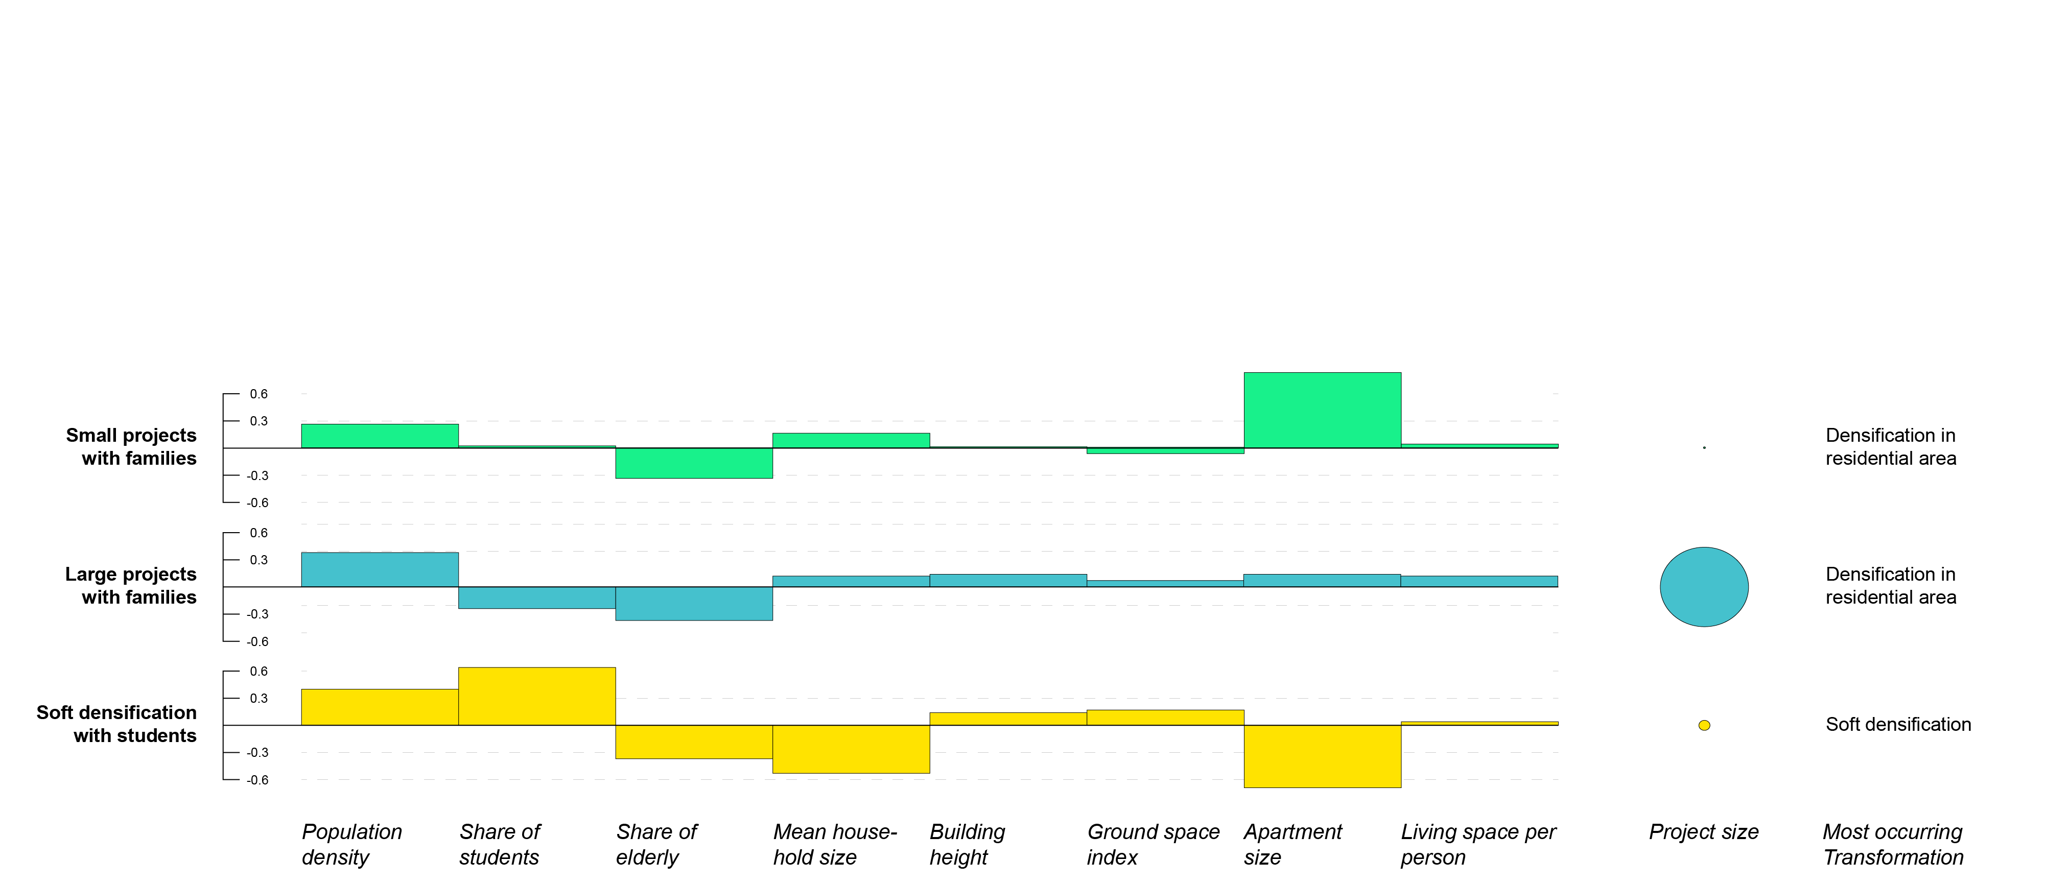
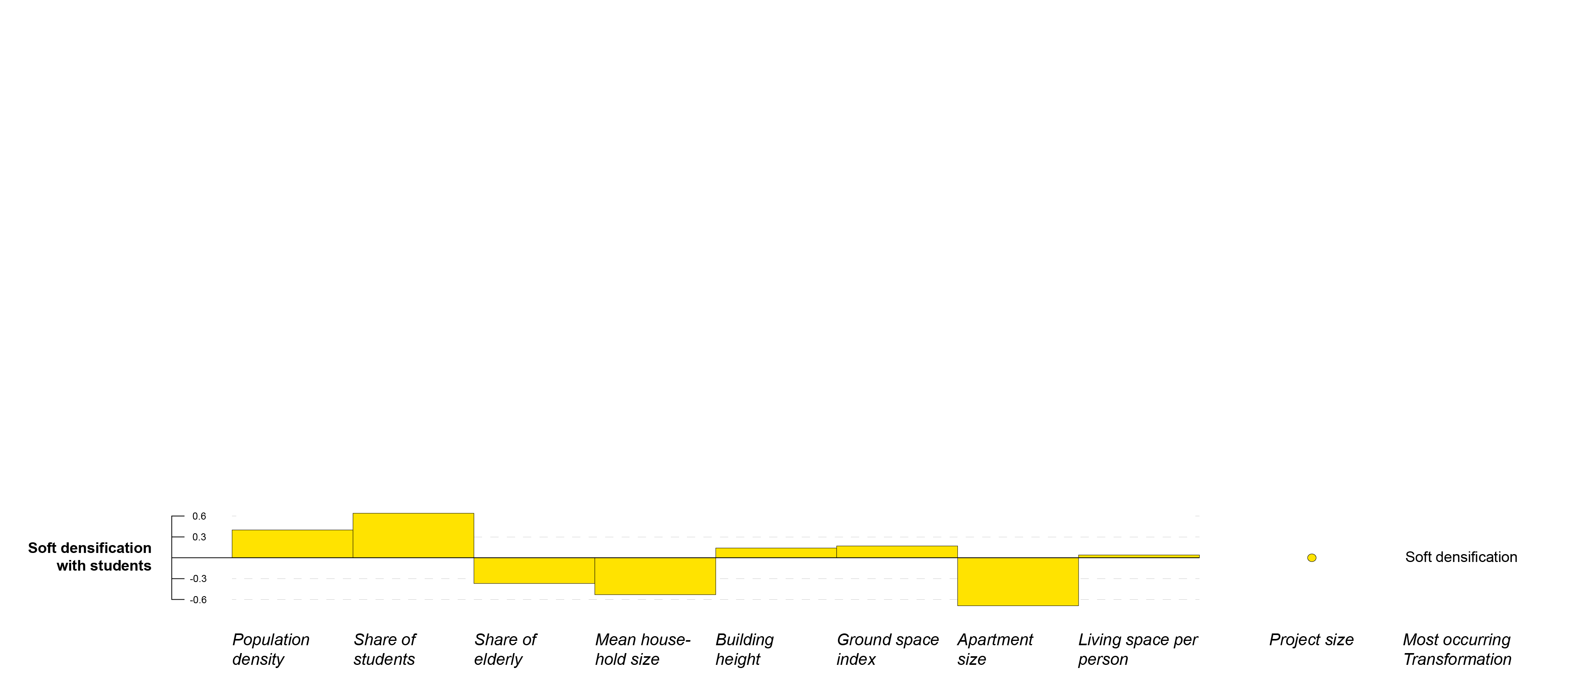
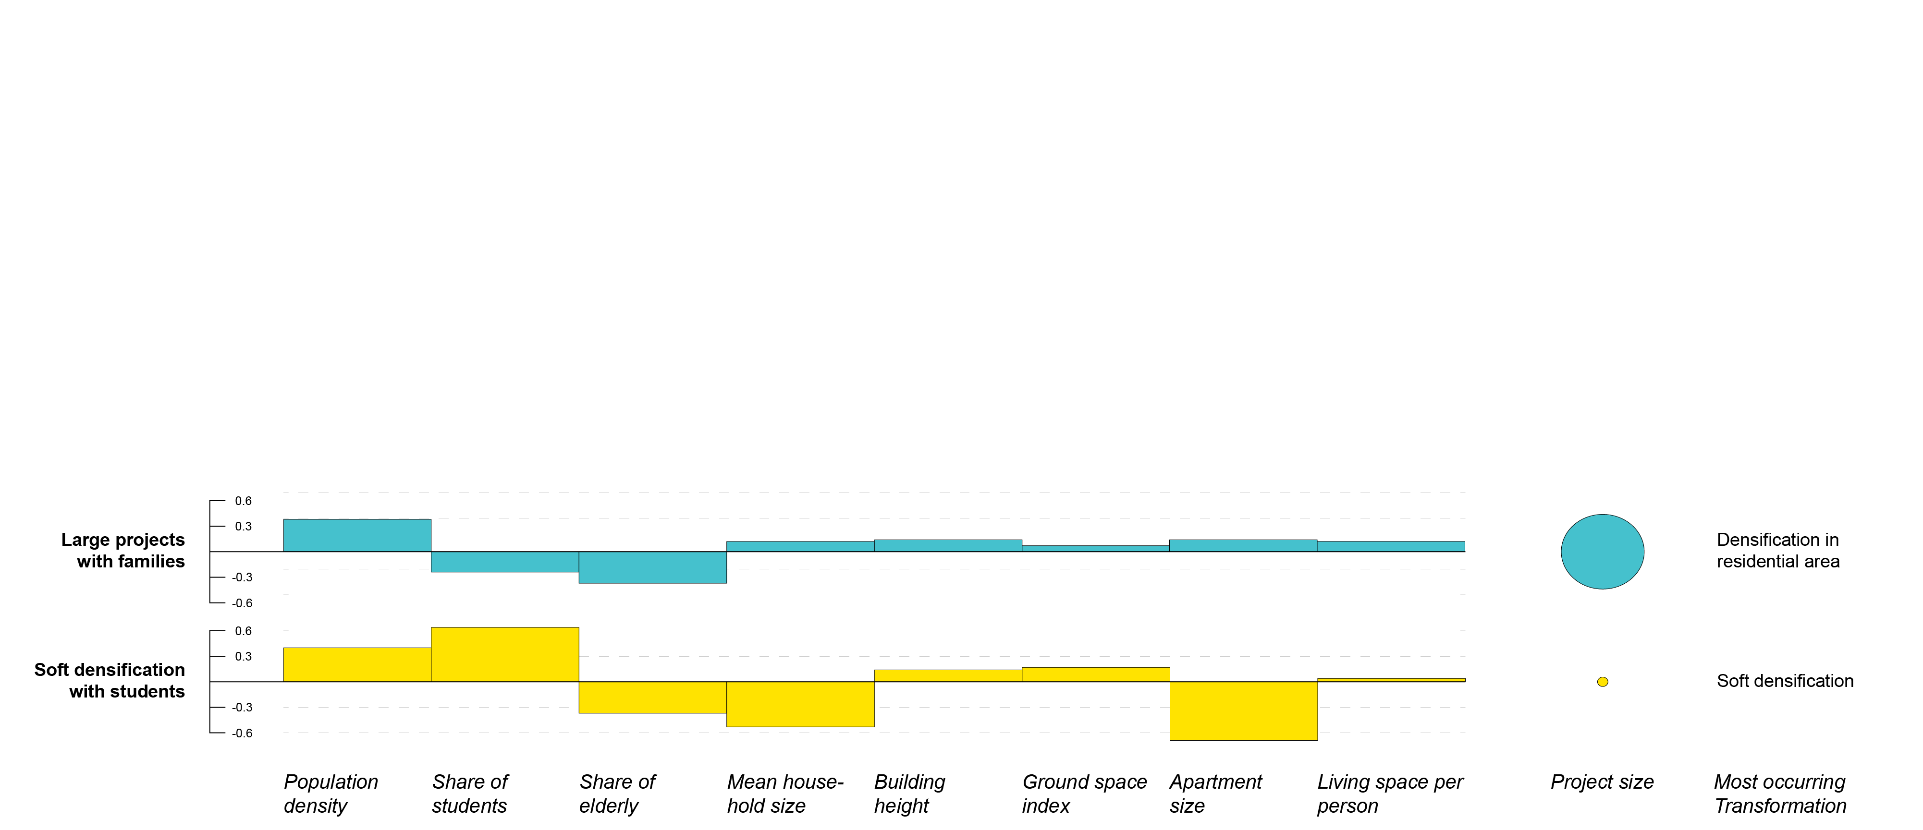
1
2
1
3
Effect of institutional framework on densification patterns across countries
4
Comparison across space; typology of densification
5
Findings

Slide 7
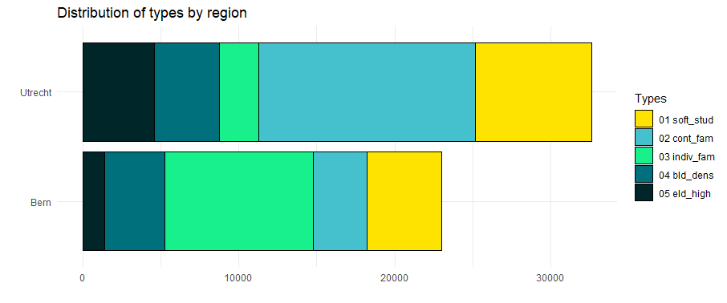
1
Effect of institutional framework on densification patterns across countries
Comparison across space; typology of densification
Findings

Slide 8
1
Effect of institutional framework on densification patterns across countries
Comparison across space; typology of densification
Findings

Slide 9
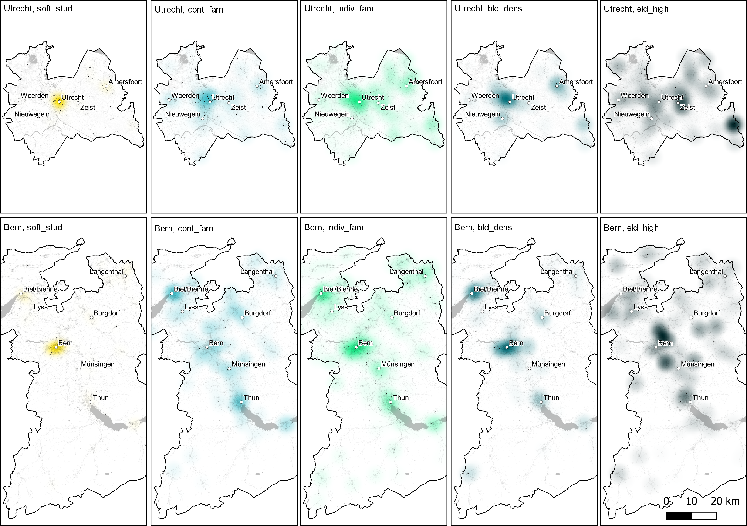
1
Effect of institutional framework on densification patterns across countries
Comparison across space; typology of densification
Findings
2
Effect of policy instrument application on project outcome
Comparison between model and reality; multi-method approach

Slide 10
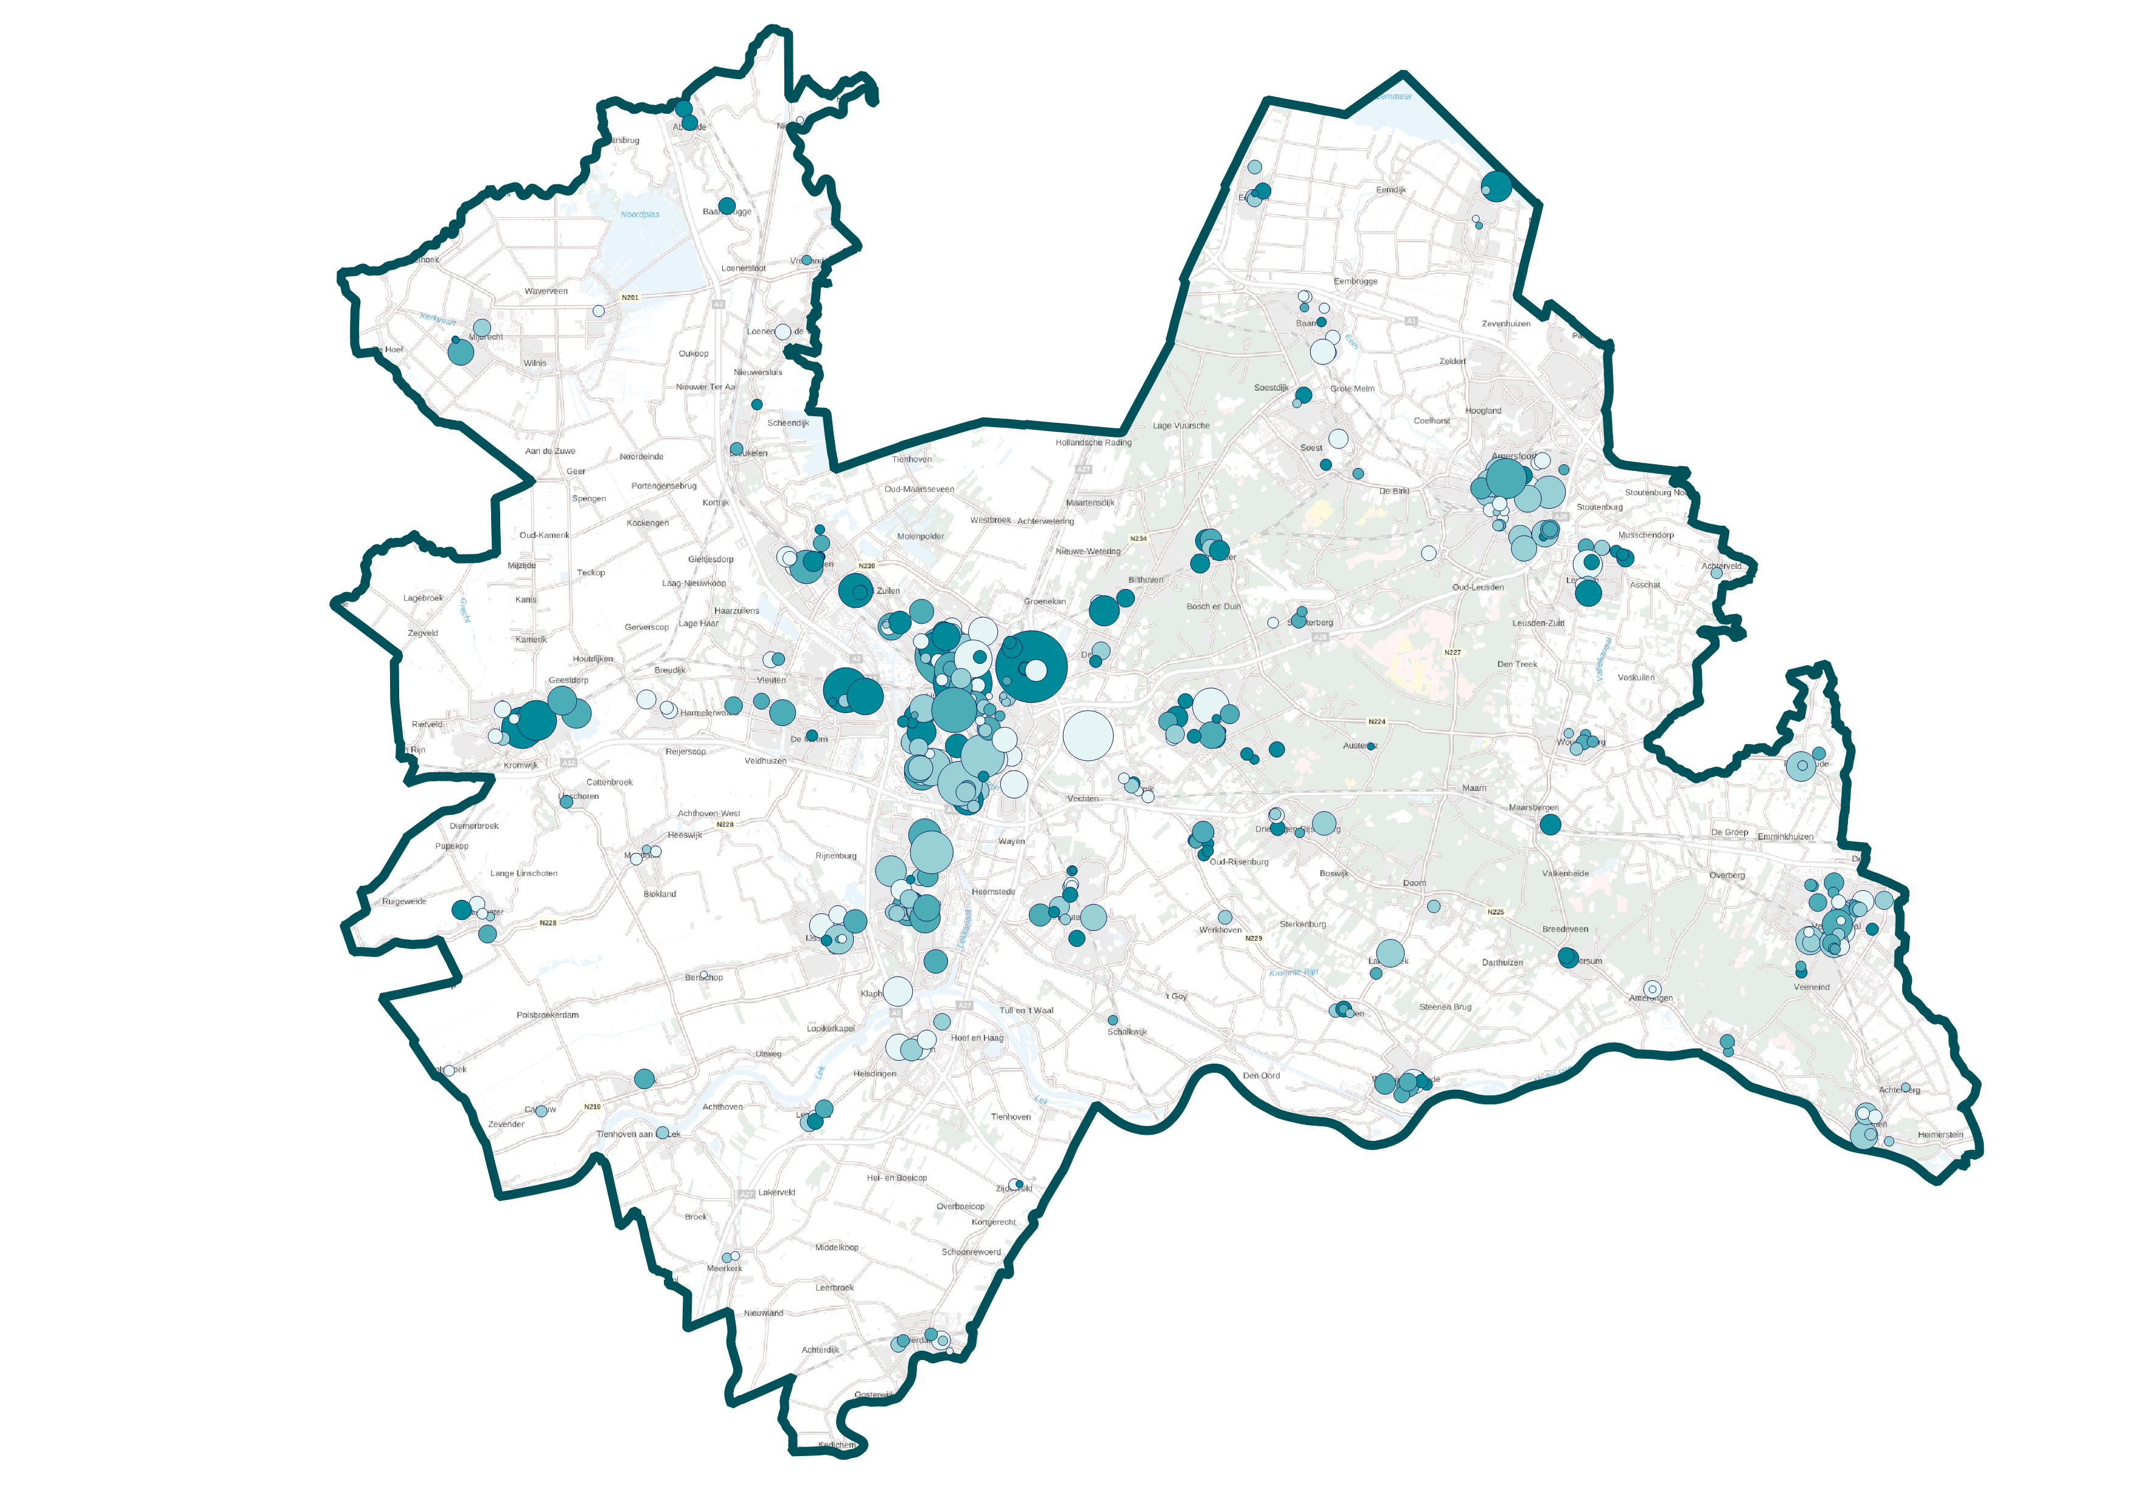
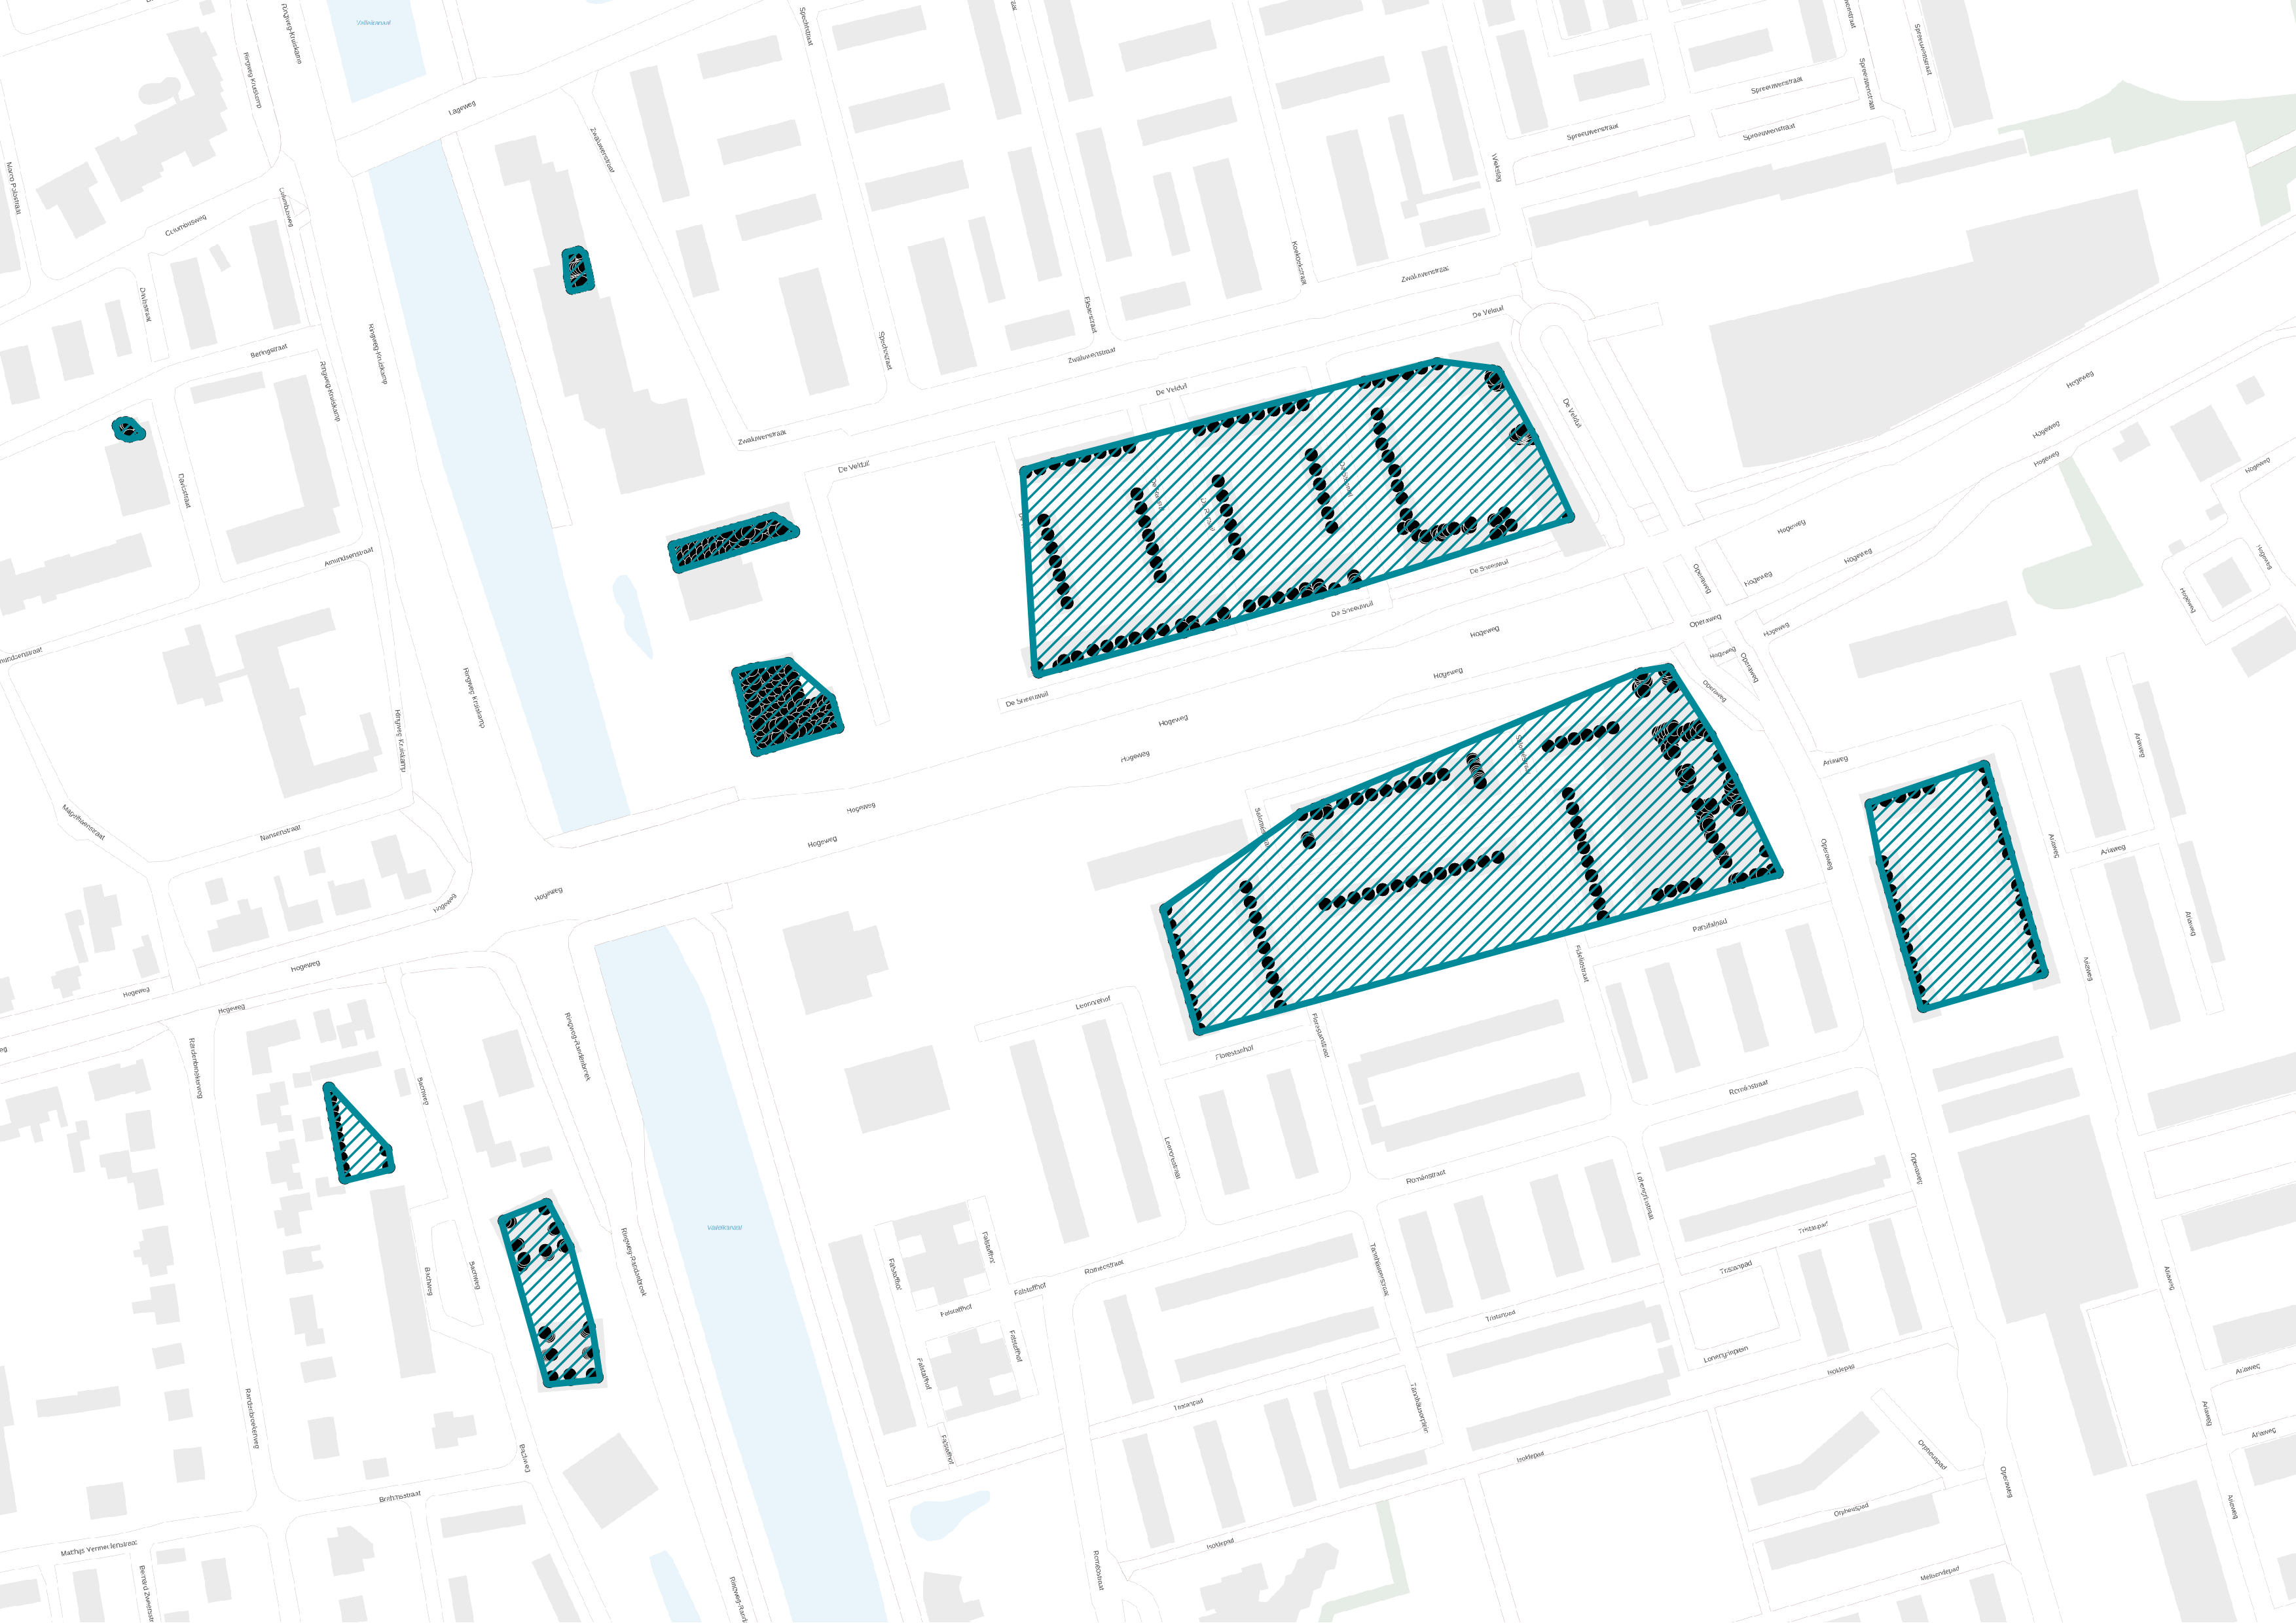
1
Effect of institutional framework on densification patterns across countries
Comparison across space; typology of densification
2
Densification projects
Effect of policy instrument application on project outcome
Comparison between model and reality; multi-method approach
Findings

Slide 11
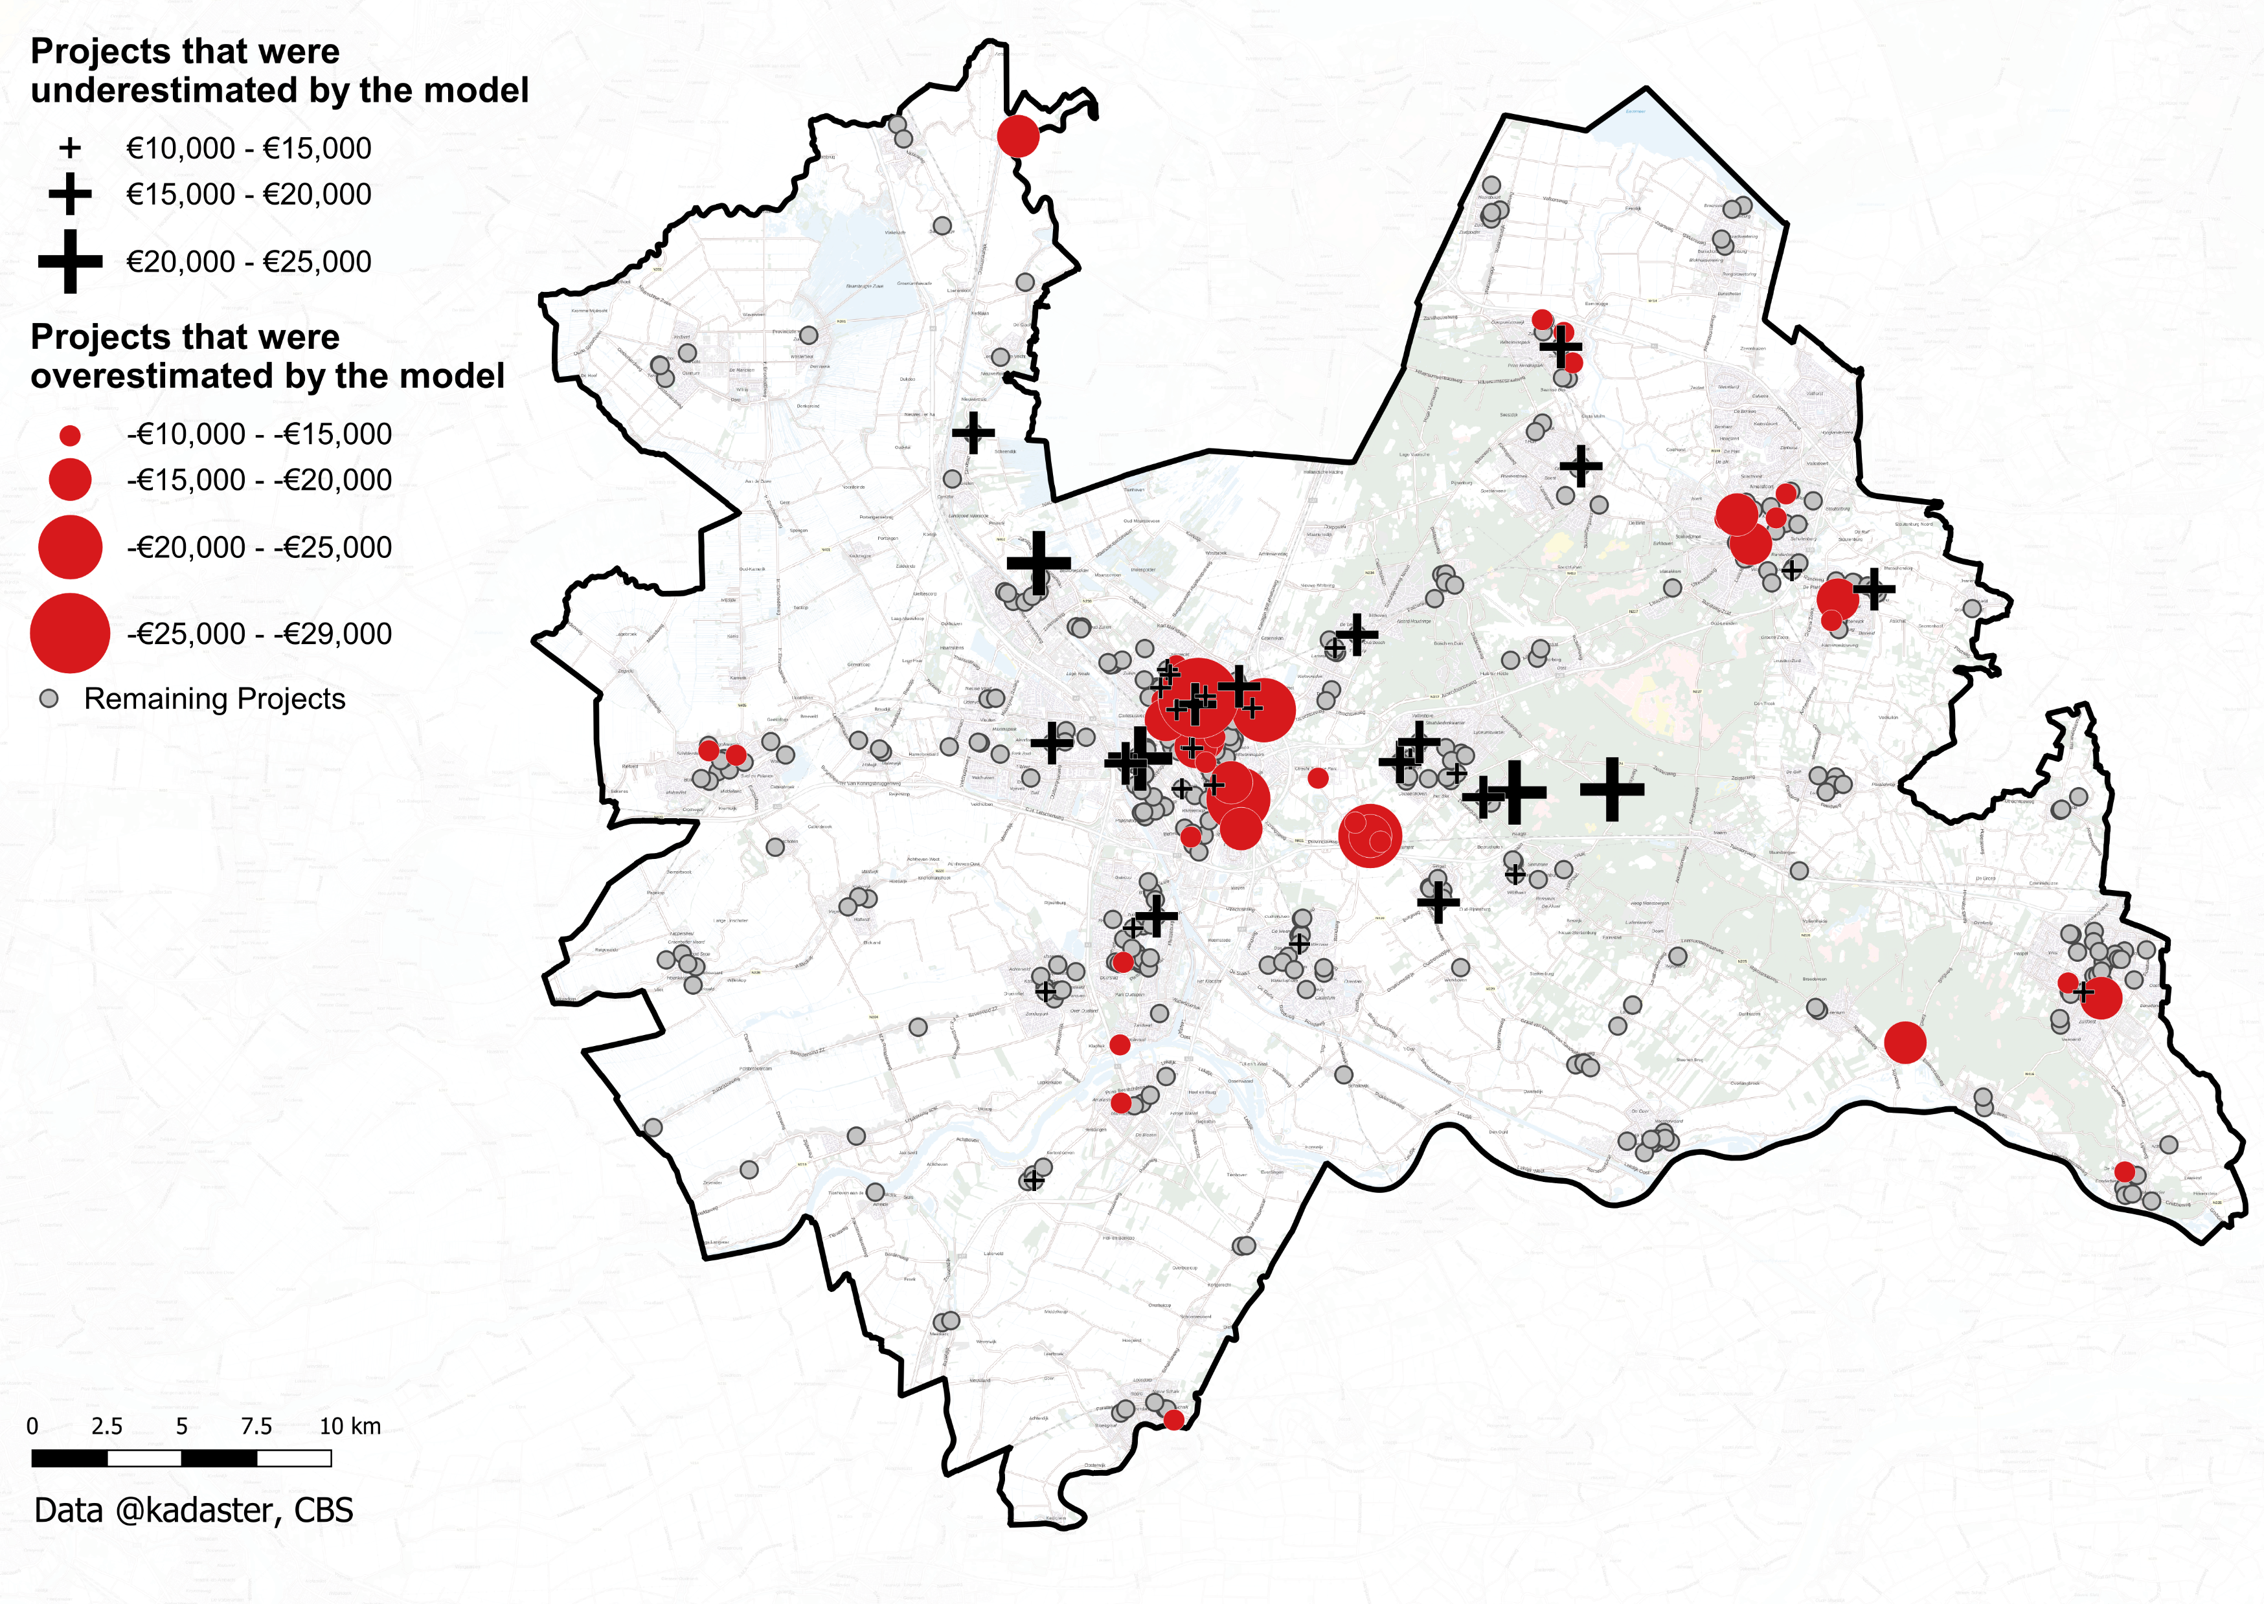
1
Effect of institutional framework on densification patterns across countries
Comparison across space; typology of densification
2
Effect of policy instrument application on project outcome
Comparison between model and reality; multi-method approach
Findings

Slide 12
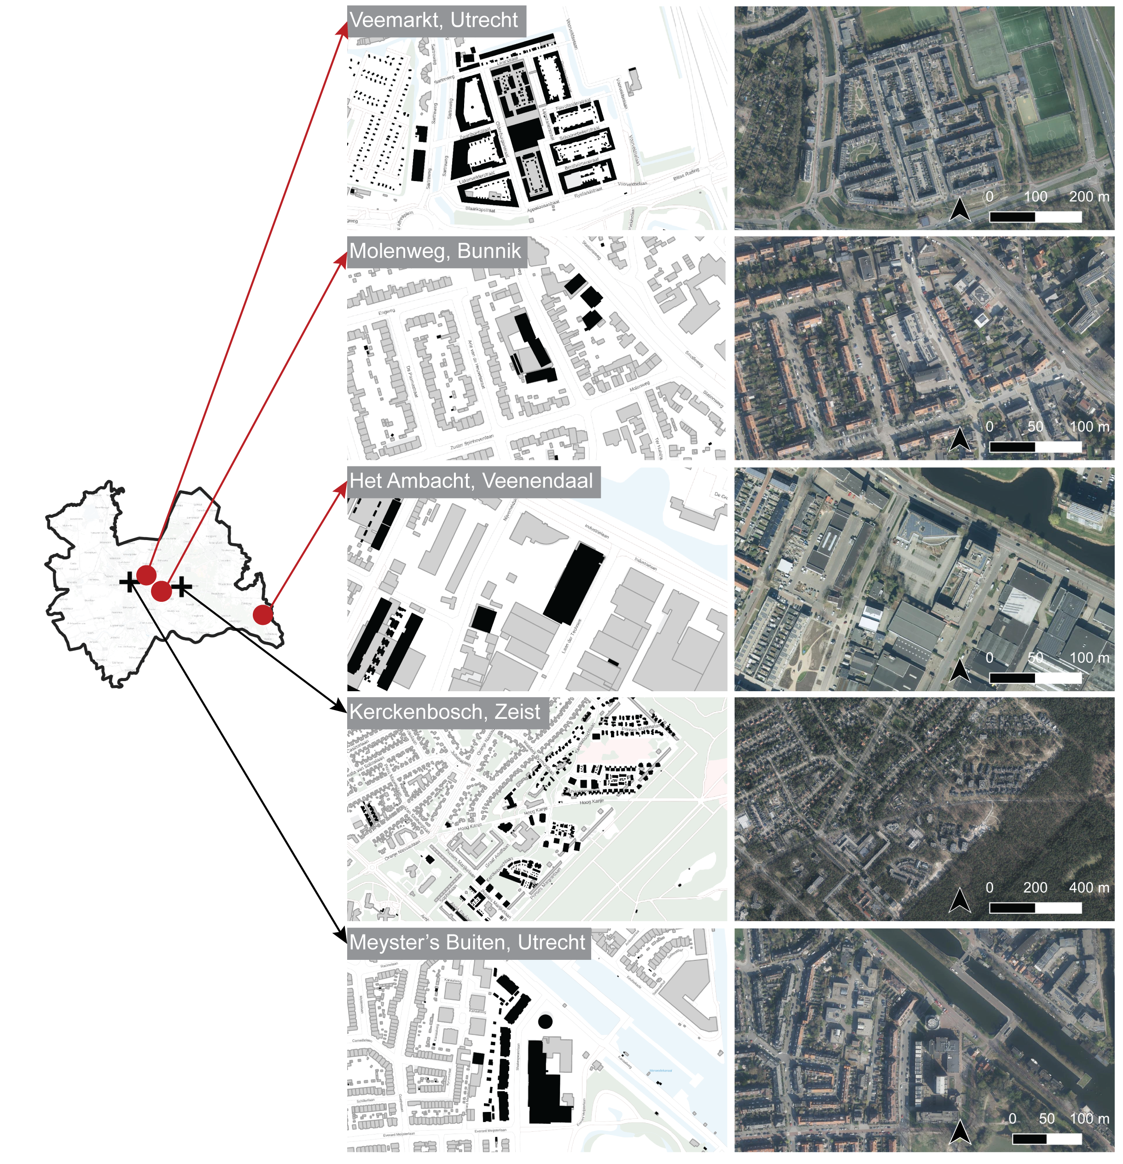
2
Effect of policy instrument application on project outcome
Comparison between model and reality; multi-method approach
Findings
3
Effect of municipal strategy on densification patterns across municipalities
Comparison across space; indicators of planning process

Slide 13
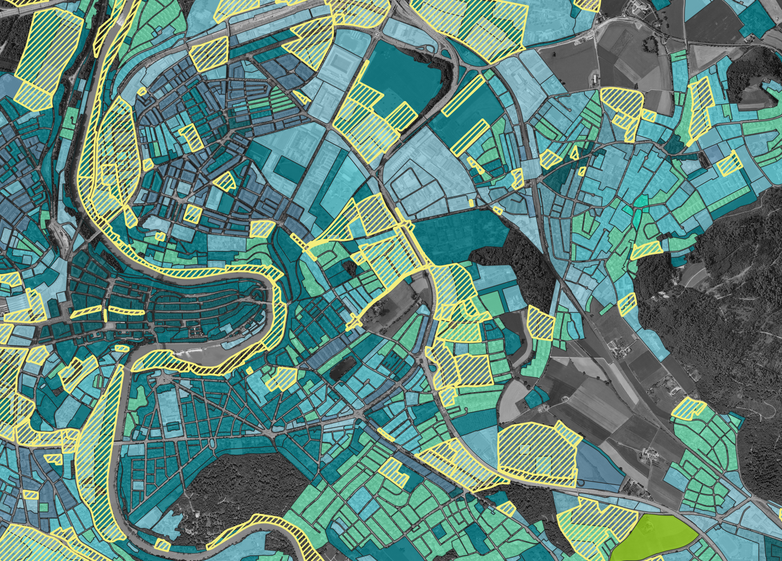
2
Effect of policy instrument application on project outcome
Comparison between model and reality; multi-method approach
3
Effect of municipal strategy on densification patterns across municipalities
Comparison across space; indicators of planning process
Findings

Slide 14
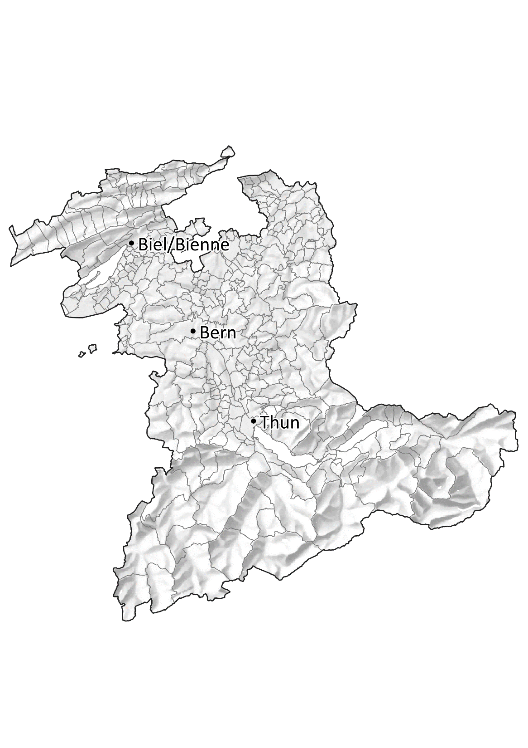
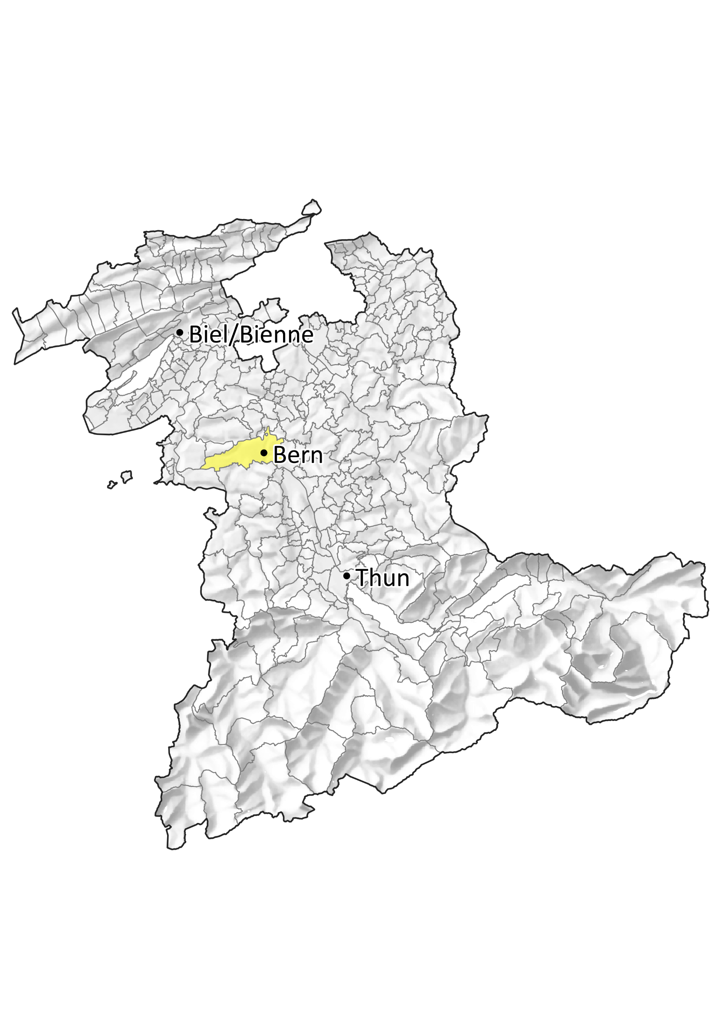
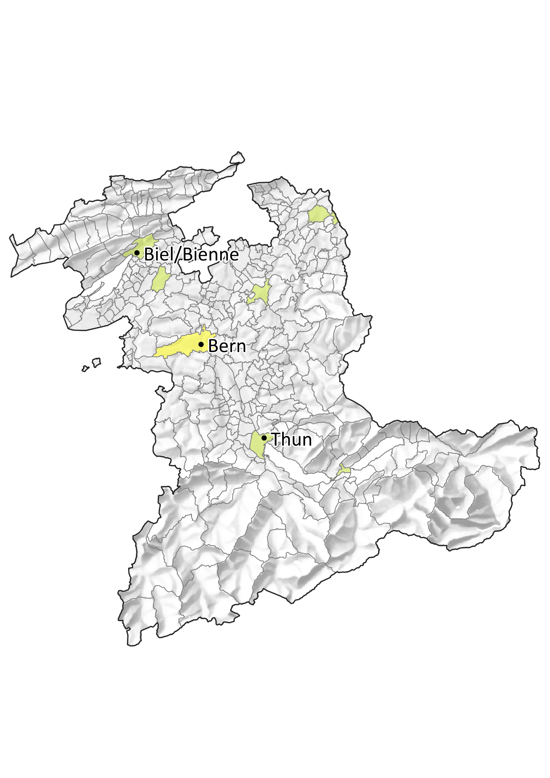
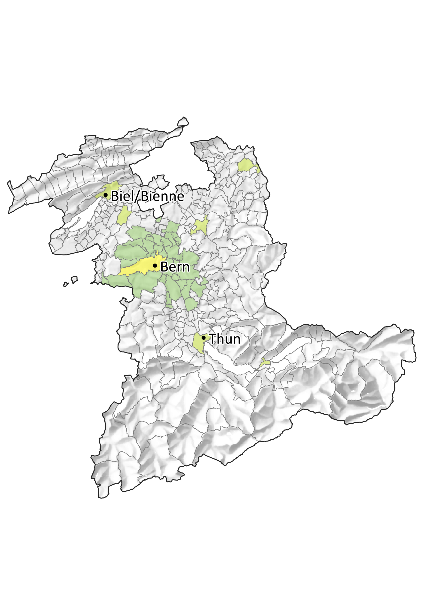
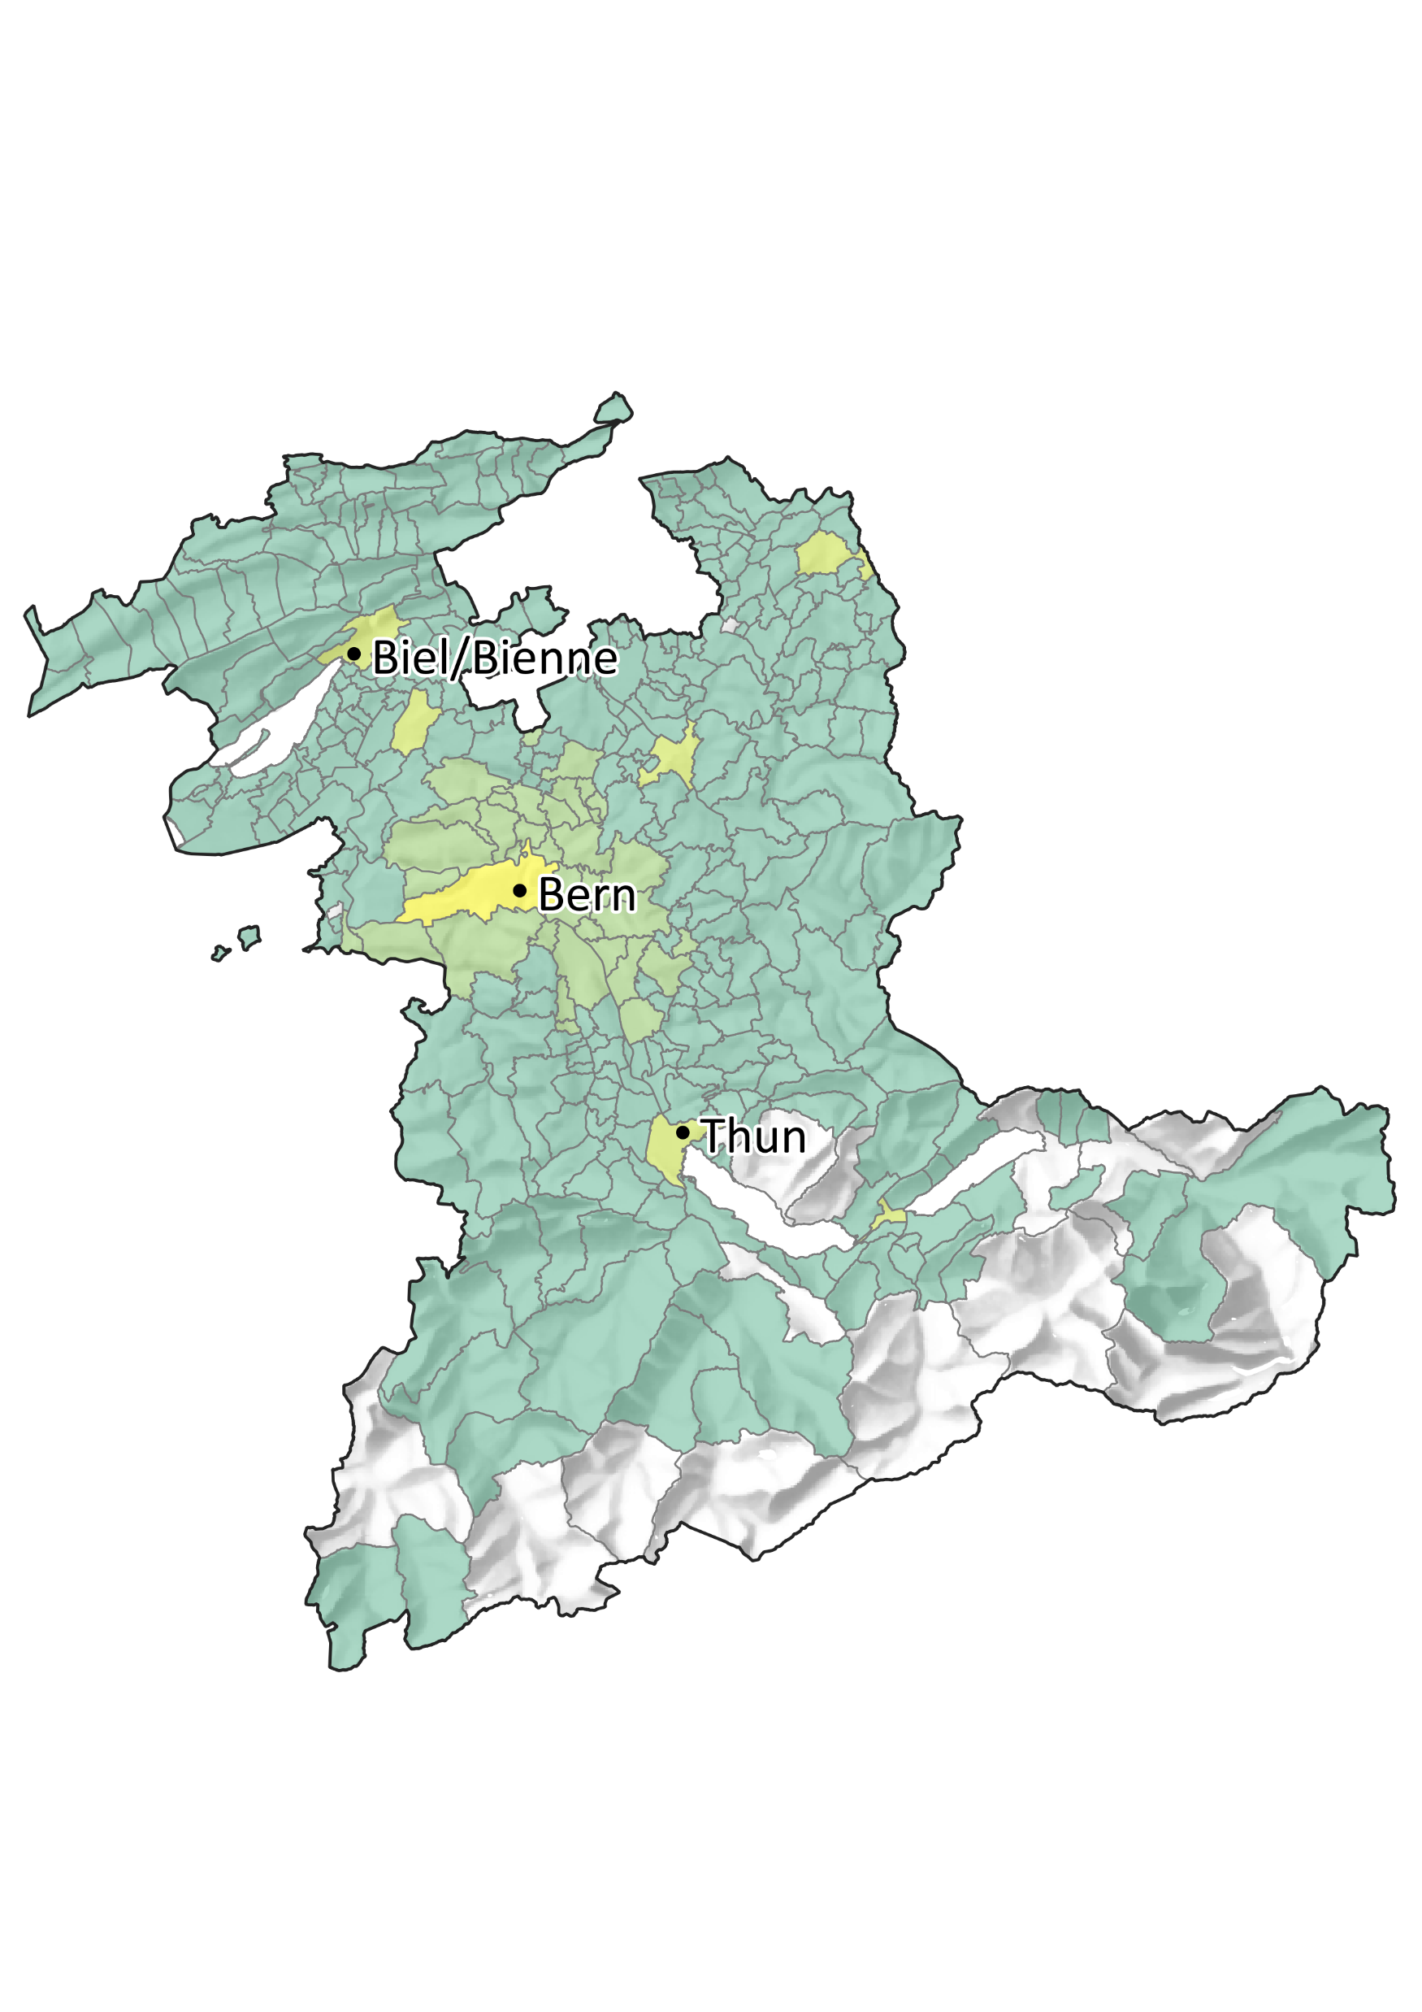
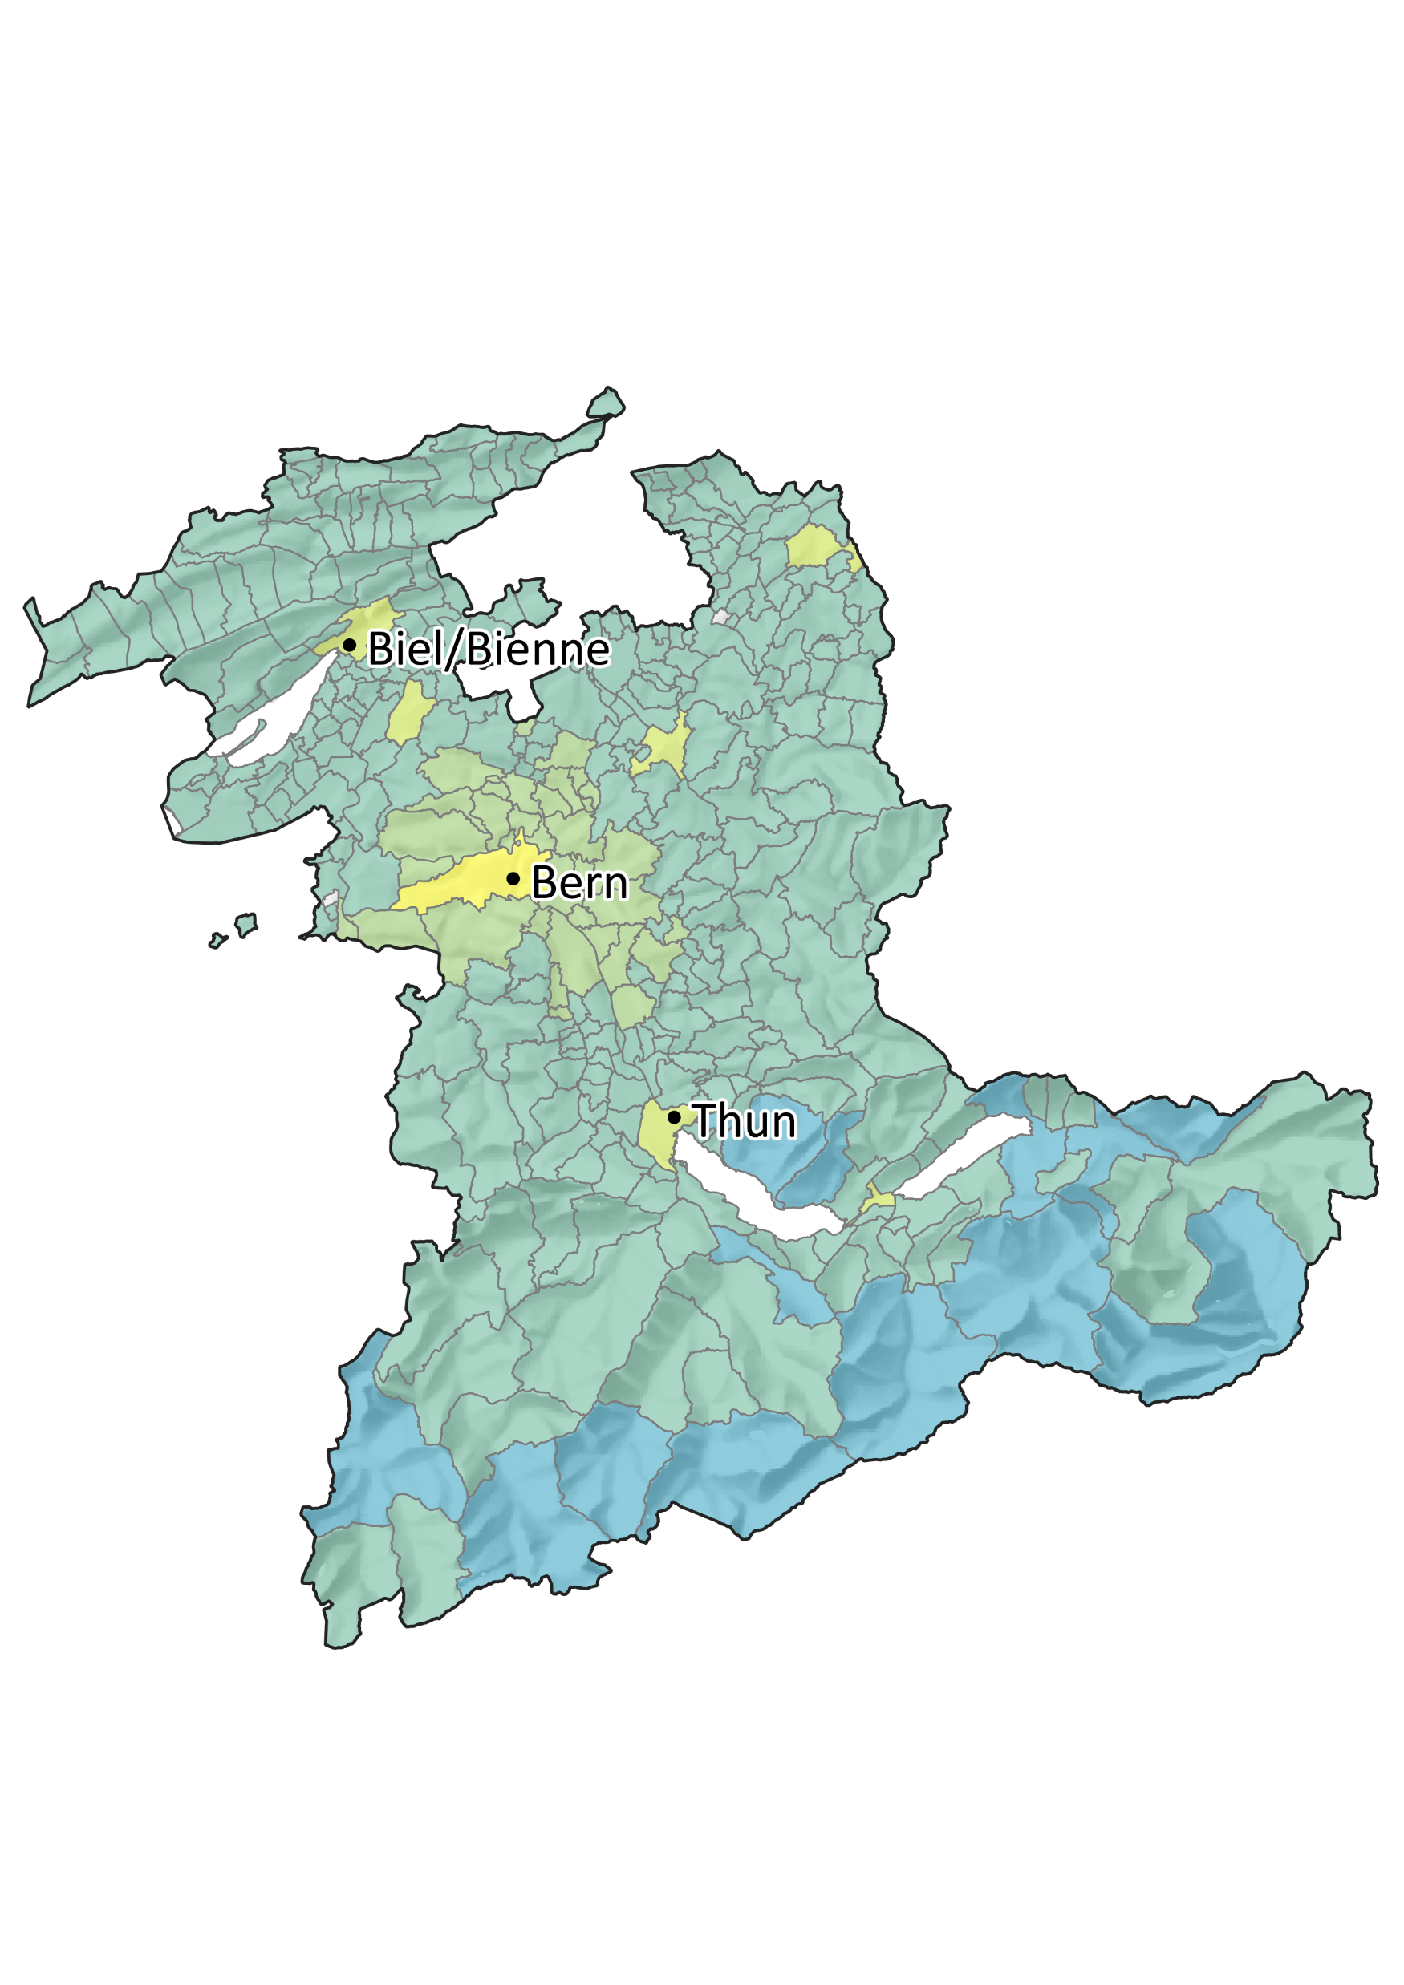
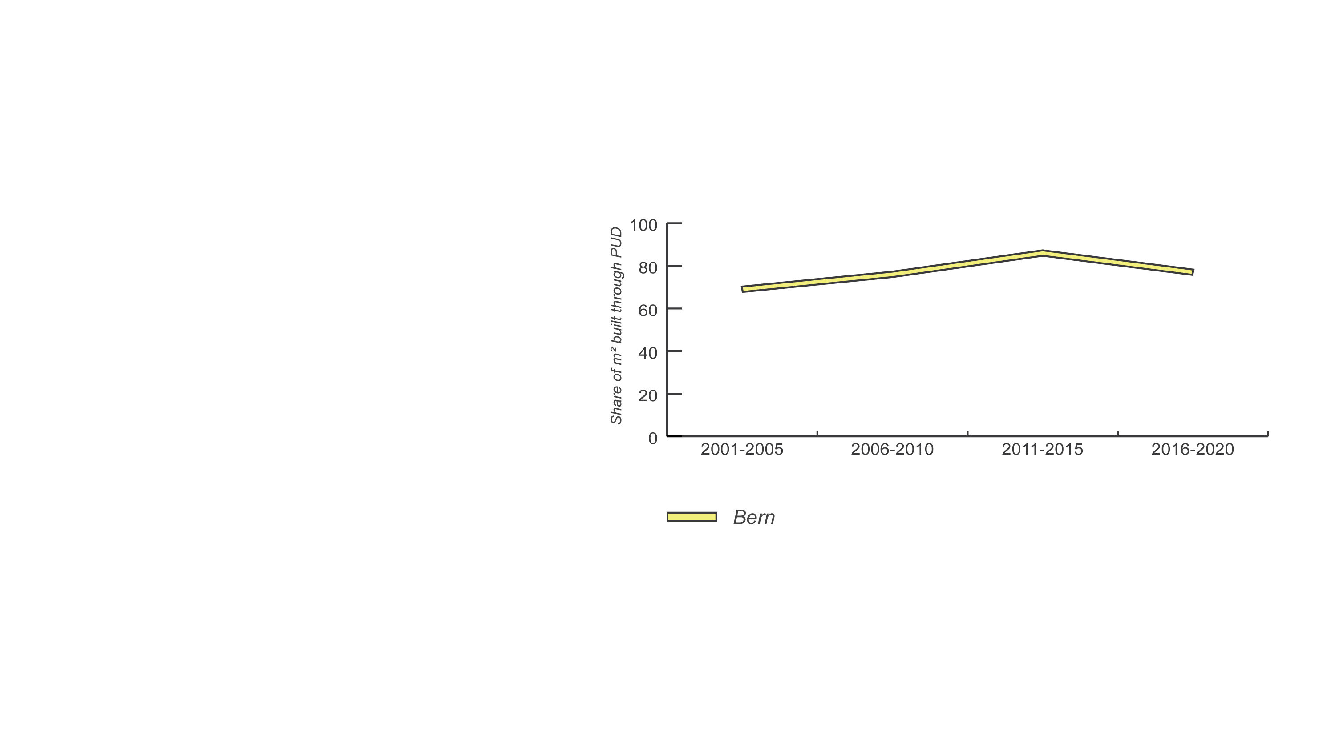
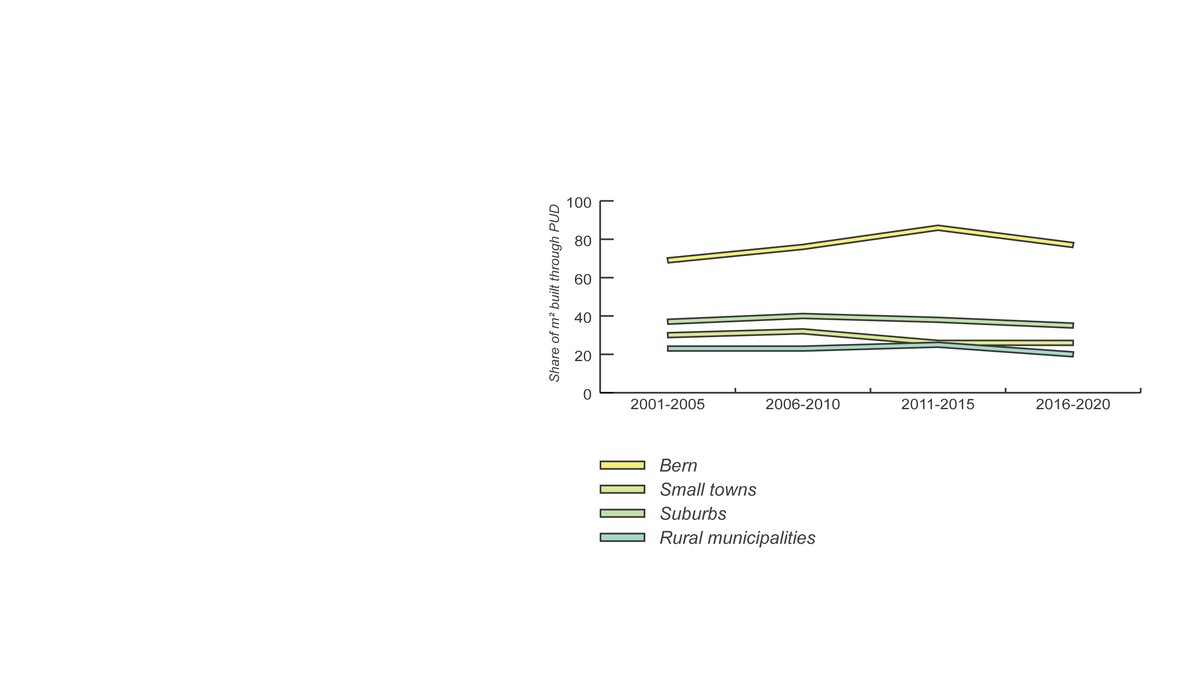
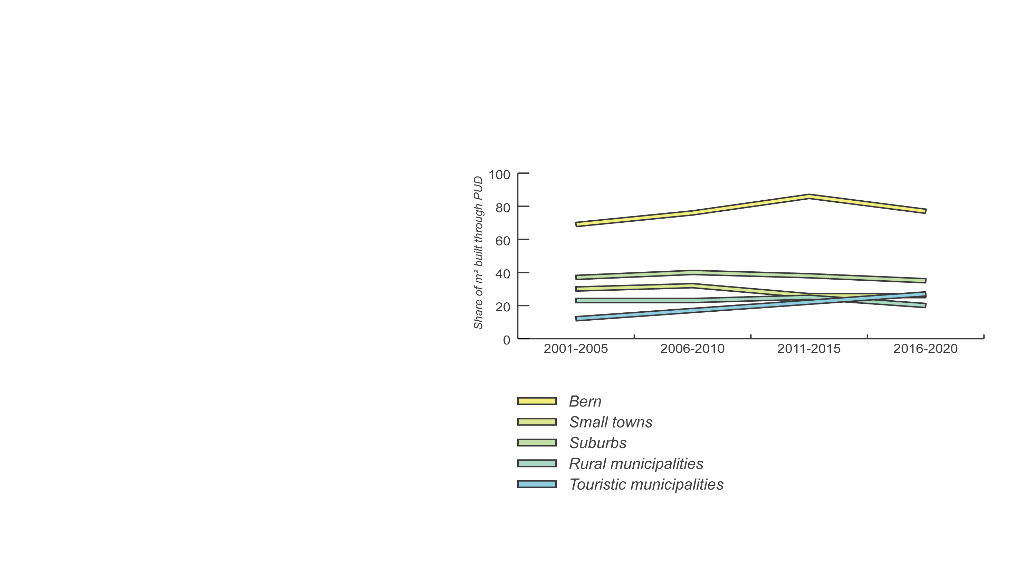
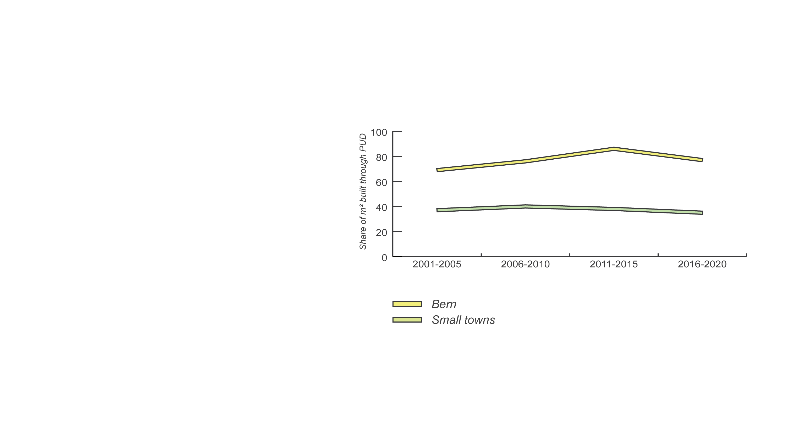
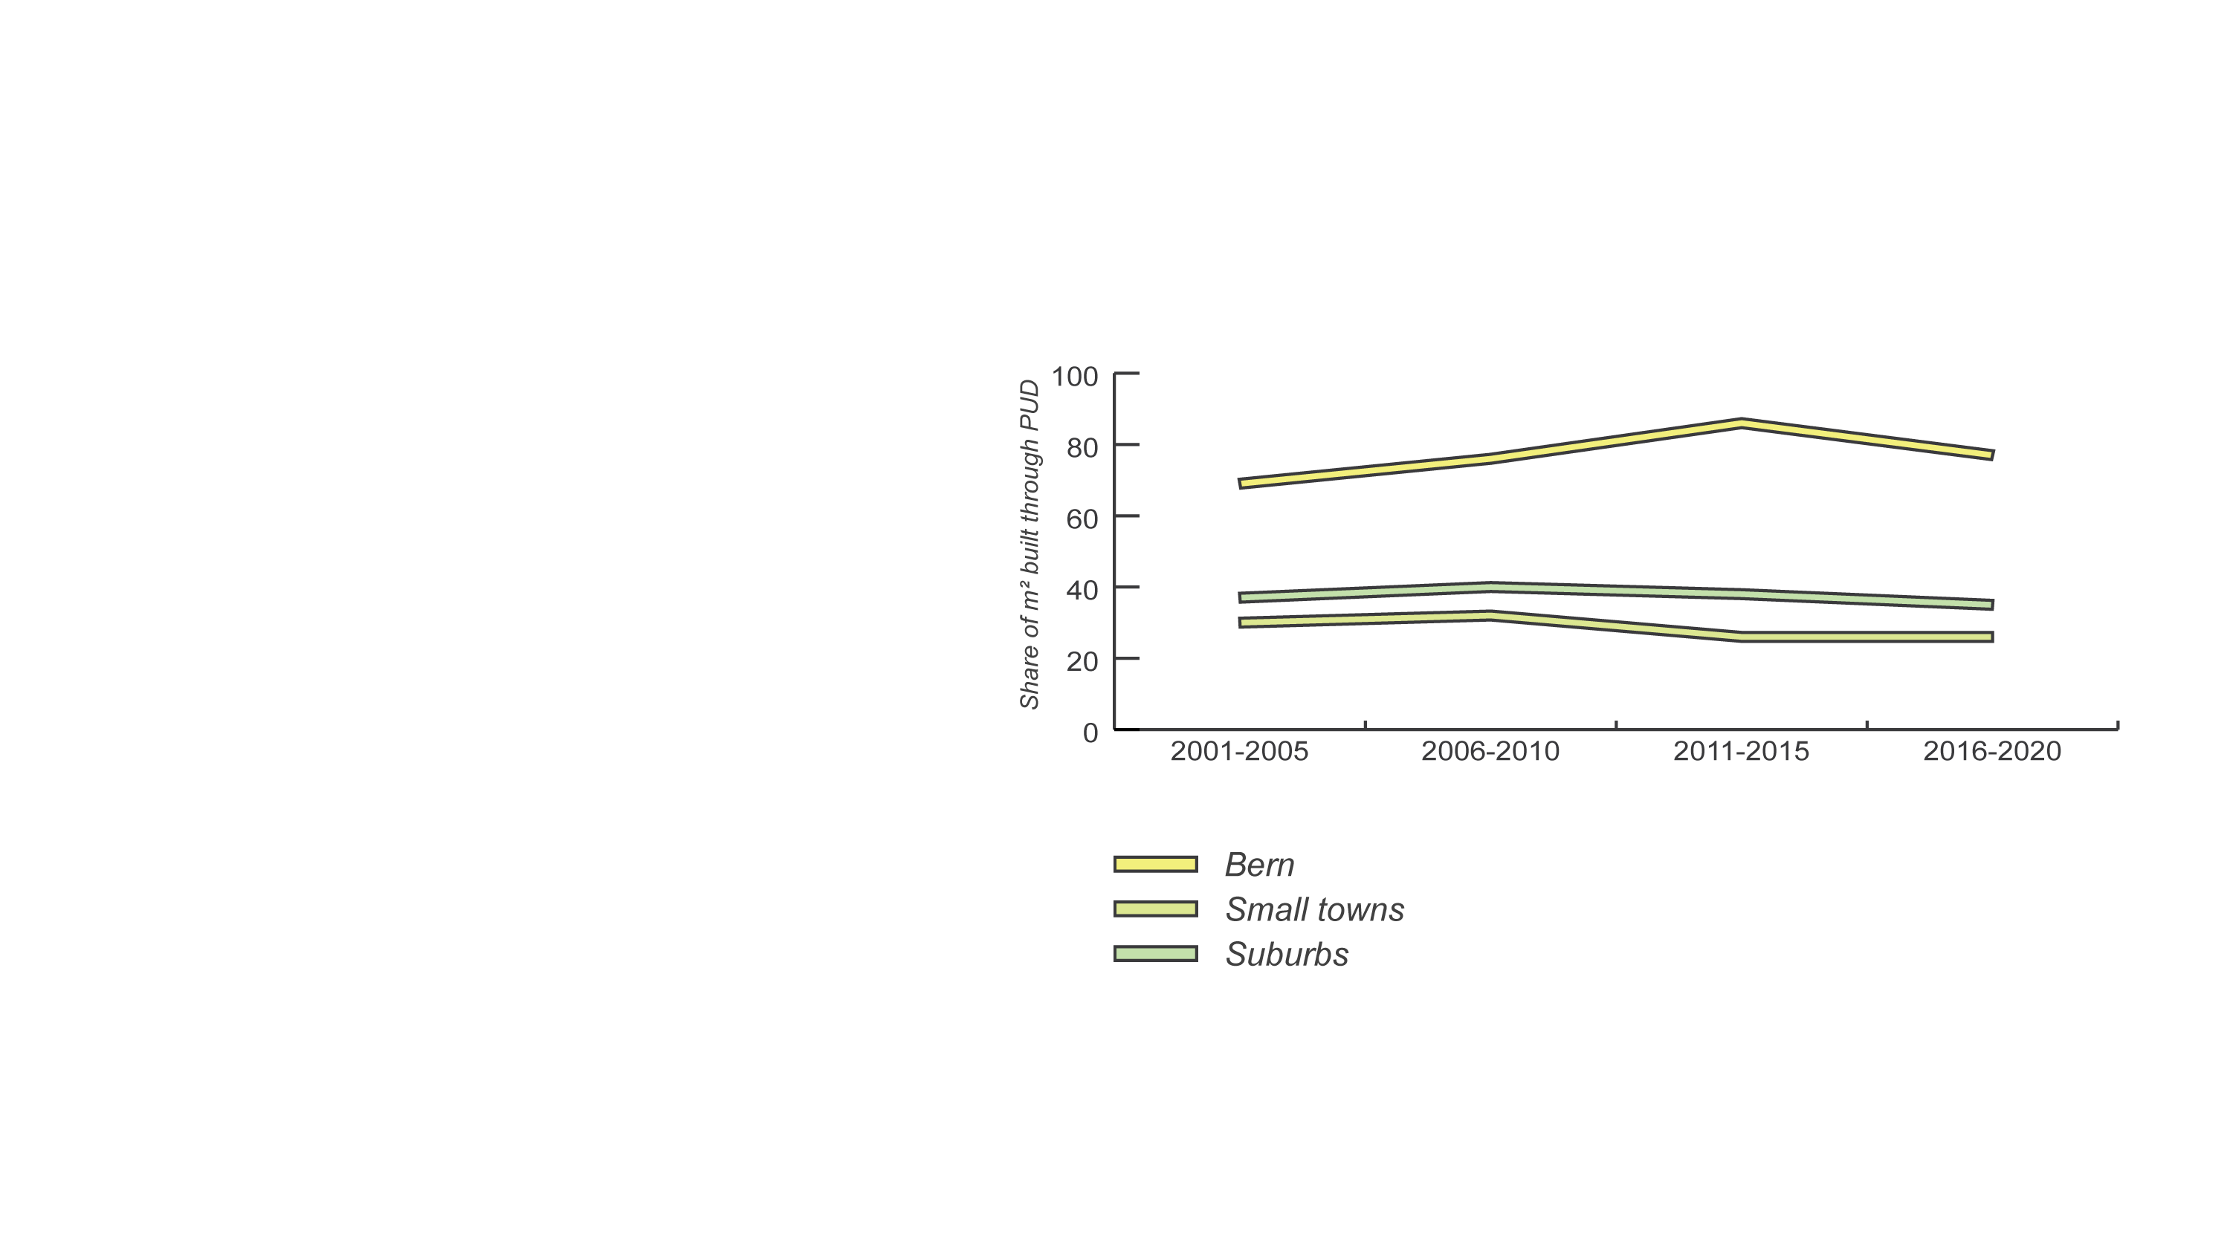
3
Effect of municipal strategy on densification patterns across municipalities
Comparison across space; indicators of planning process
Findings

Slide 15
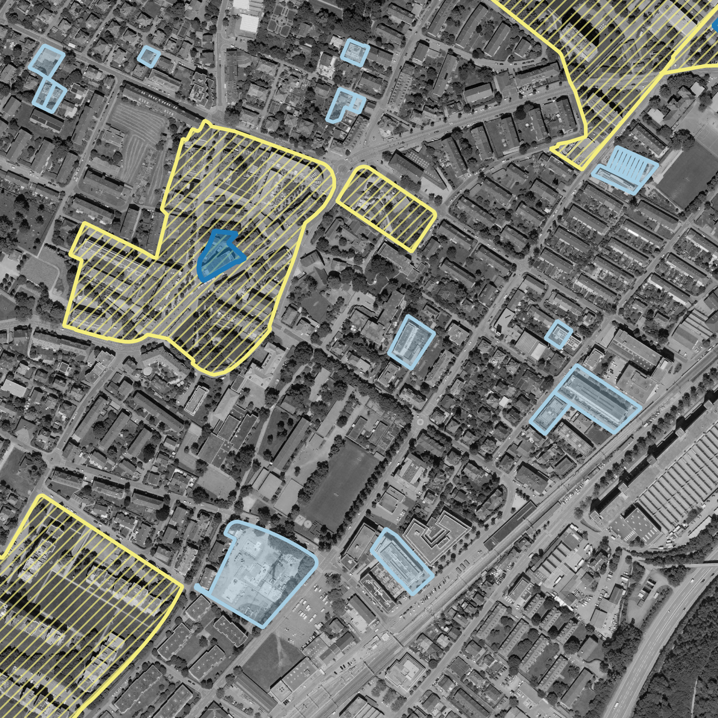
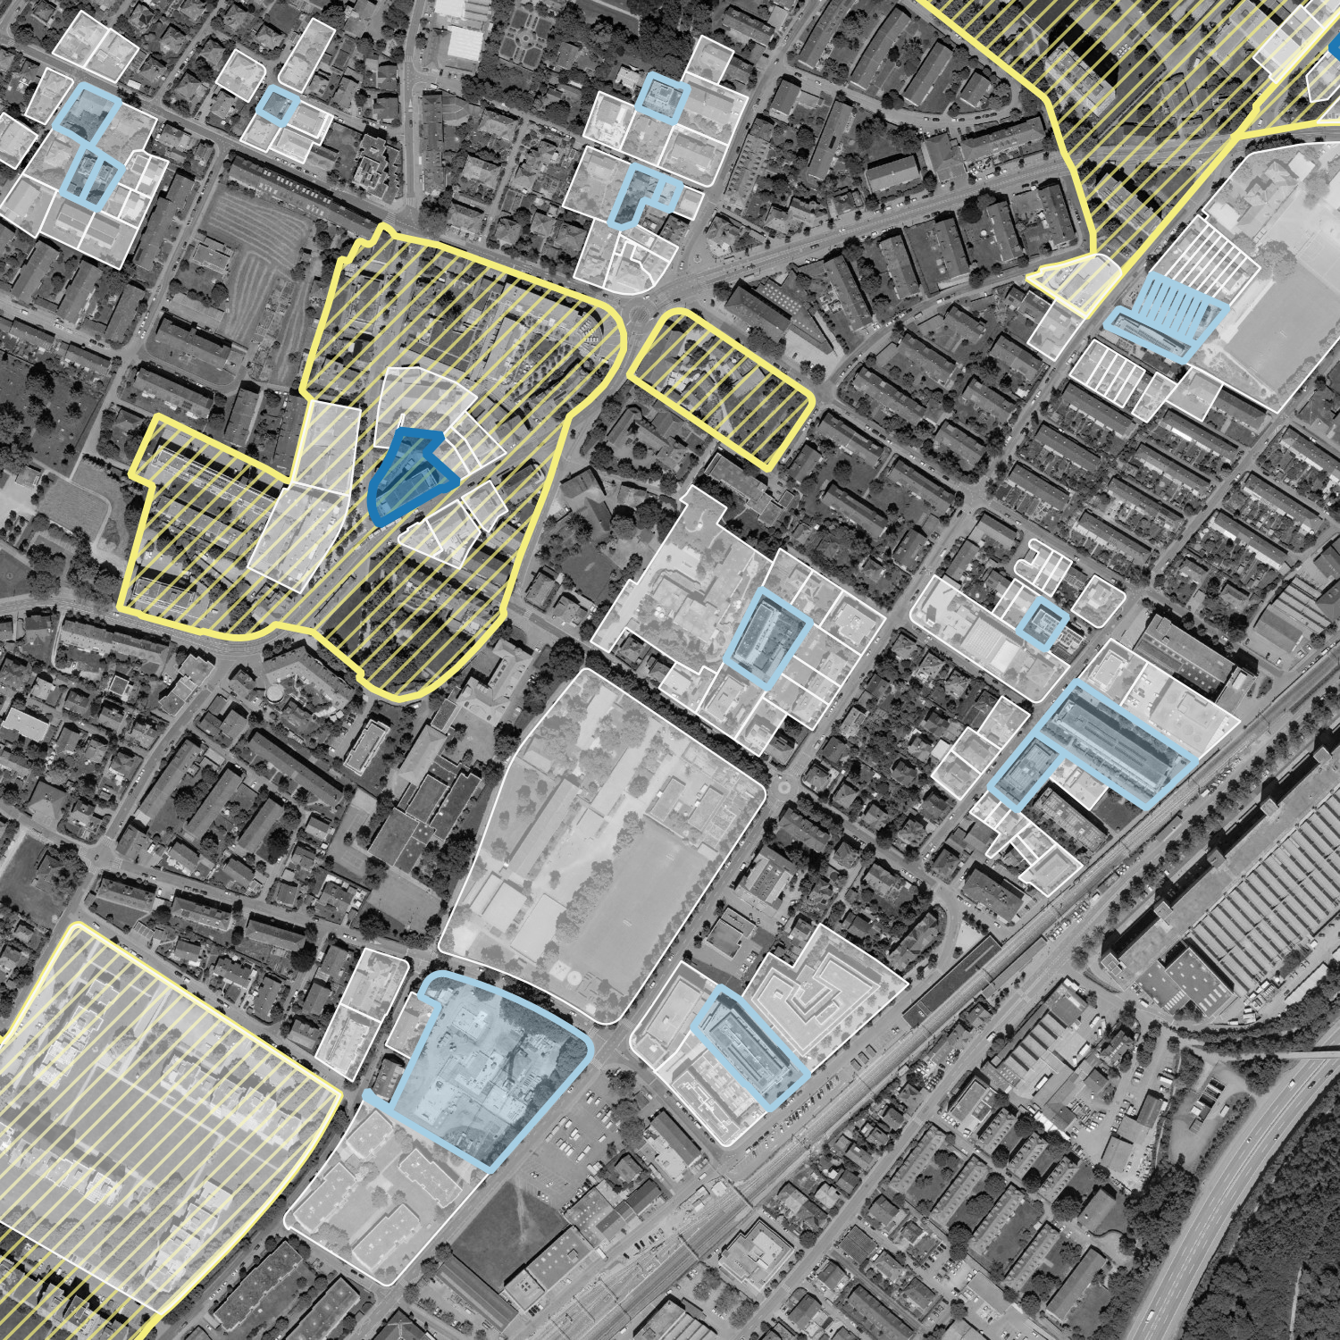
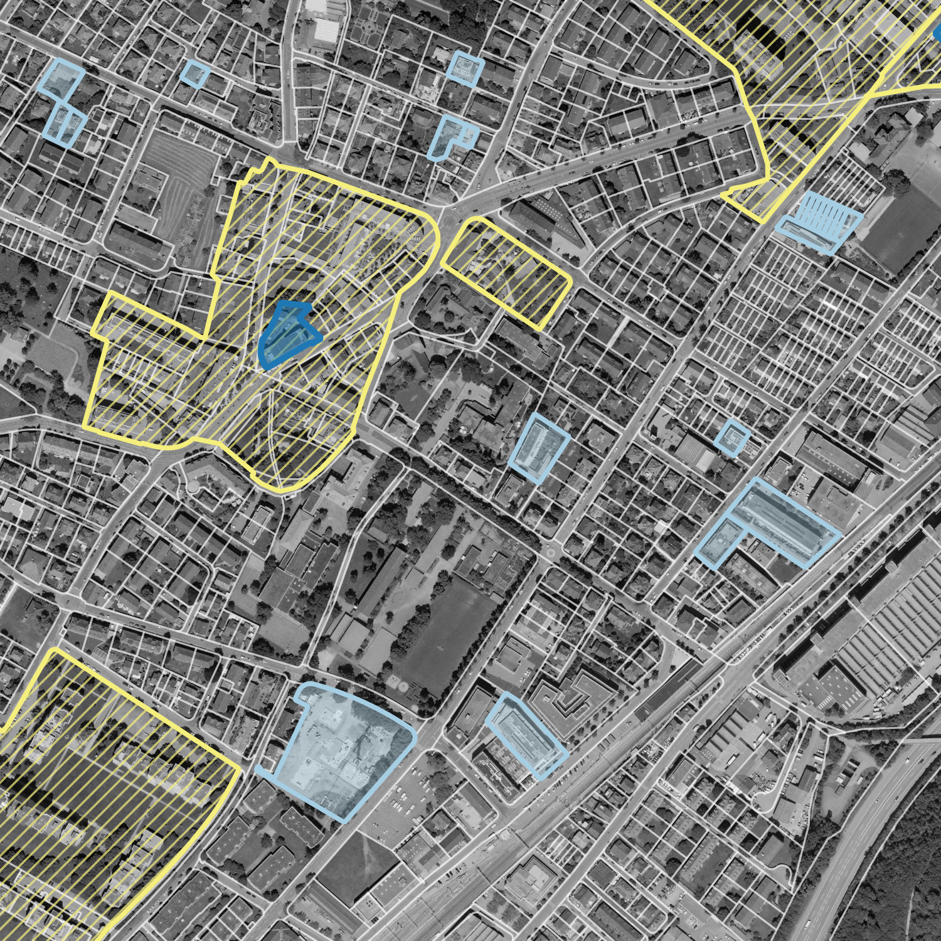
And i thought, well there are probably differences between municipalities in terms of how much they use this instrument, and what they achieve with it compared to the conventional zoning. Higher densities or use mix, or more densification under difficult circumstances. And i‘m a bit afraid that I would totally drown you now if I also go through each of the indicators, and discuss the results.
3
Density
Use and use mix
Density increase in low-density neighborhoods
Complexity of parcel change
Densification projects
Planned Unit Development
Effect of municipal strategy on densification patterns across municipalities
Comparison across space; indicators of planning process
Densification projects
Findings

Slide 16
Quantifying the degree to which undesirable or difficult densification processes occur
Acknowledging municipalities’ strategic action
Non-conforming development (housing type, residents, density)
Compare to market expectation
Complex changes (land use, ownership, parcel structure)
Use regional analyses to find surprising cases for qualitative study
How does the comparison of densification patterns contribute to tracing land policy effects?
Conclusion

Slide 17
Capturing land policy effects with spatial analysis
a Comparison of densification patterns in Utrecht and Bern
Götze, V., & Jehling, M. (2022). Comparing types and patterns : A context-oriented approach to densification in Switzerland and the Netherlands. Environment and Planning B: Urban Analytics and City Science, 0(0), 1–15. https://doi.org/10.1177/23998083221142198
Götze, V., Bouwmeester, J. A., & Jehling, M. (2023). For whom do we densify? Explaining income variation across densification projects in the region of Utrecht, the Netherlands. Urban Studies. https://doi.org/10.1177/00420980231205793
Götze, V., Gerber, J.-D., & Jehling, M. (2024). Mapping municipal land policies: flexible zoning application for densification. Buildings & Cities. (forthcoming)

